Slide 1
Supplementary Slides

Slide 2
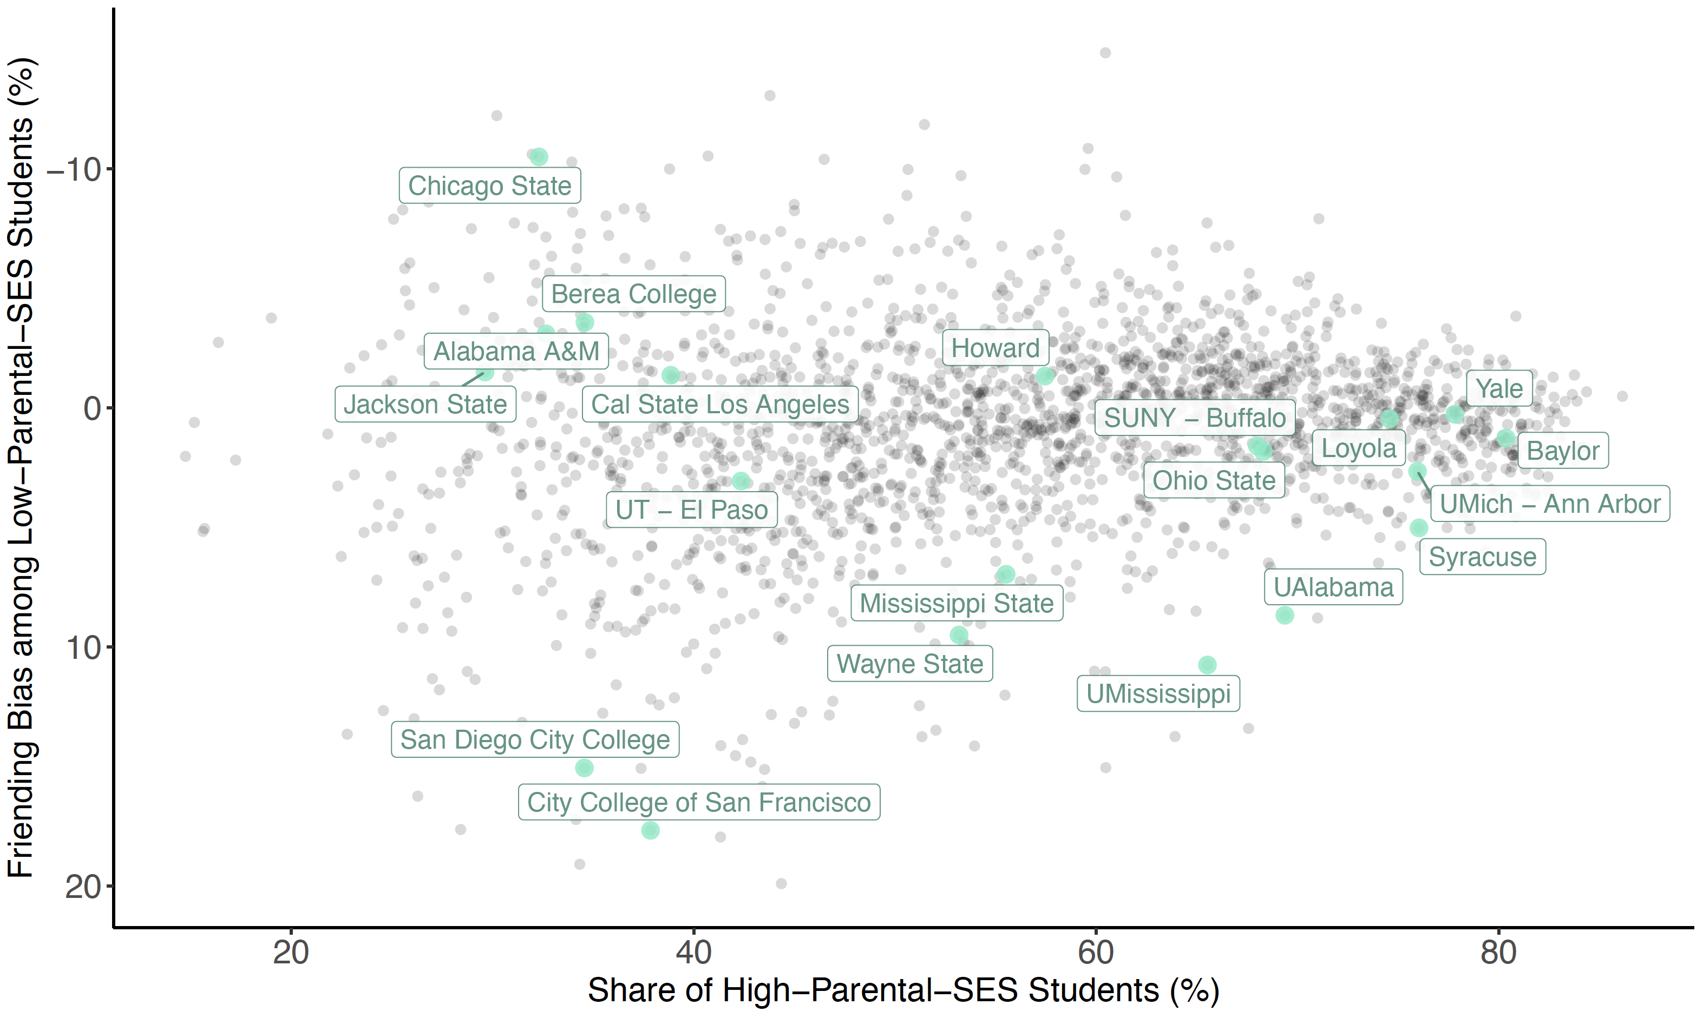
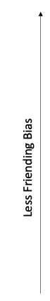
Friending Bias vs. Exposure to High-SES Students, by College
Among Low-SES Students in 1990-2000 Birth Cohorts
Notes:
2-5B

Slide 3
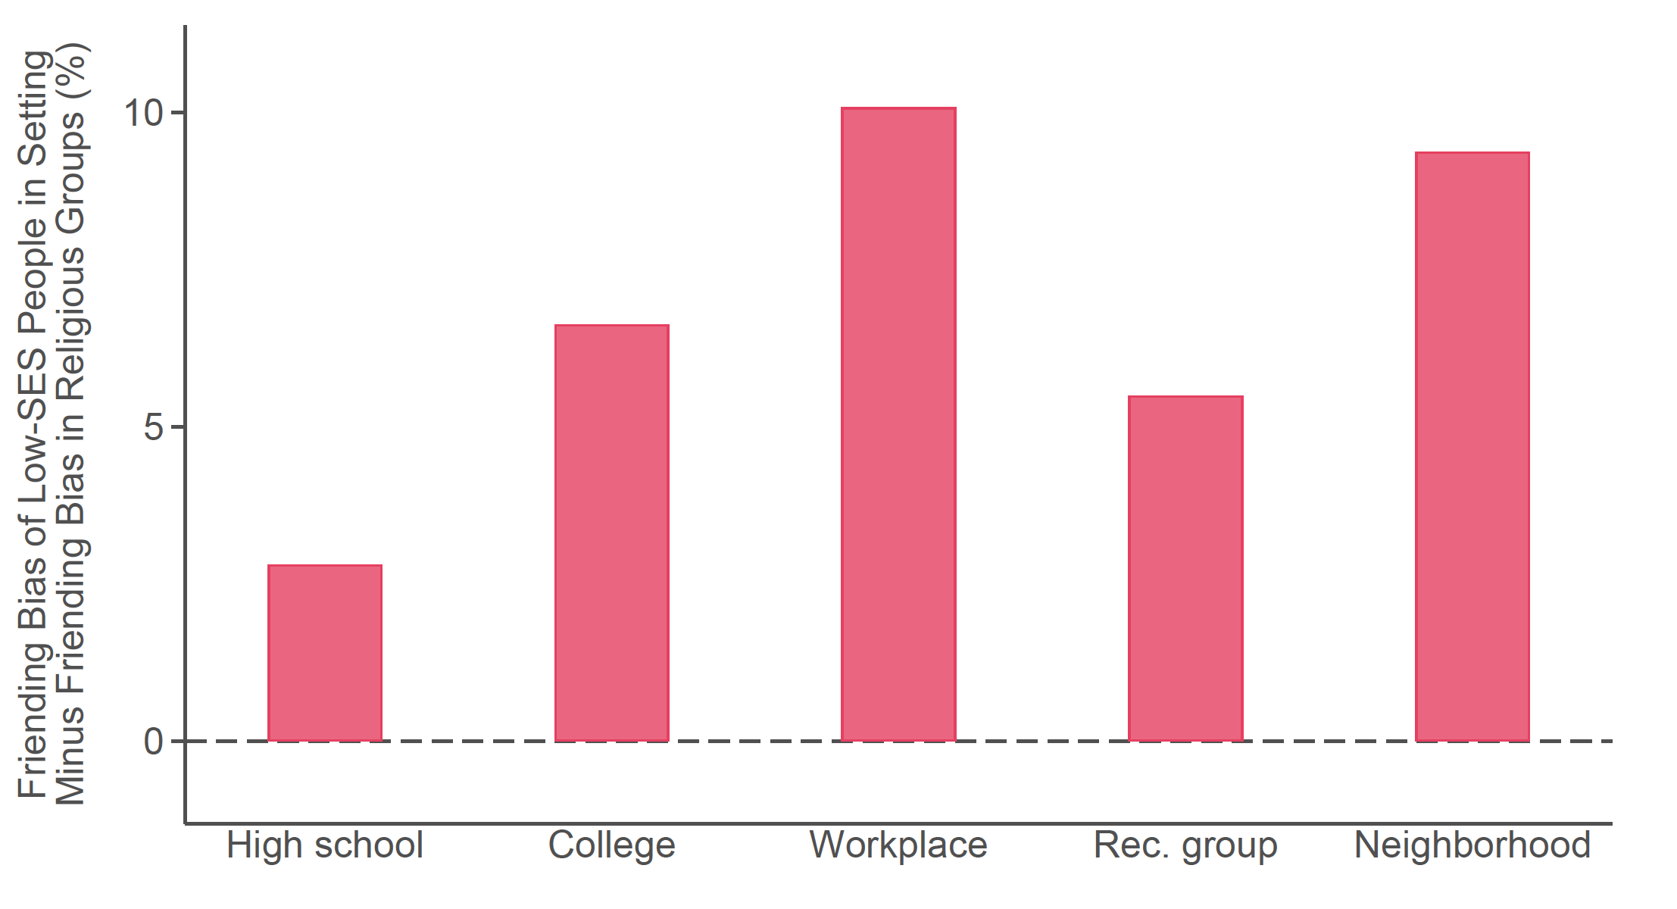
Difference in Friending Bias Exhibited in Other Groups vs. Religious Groups
Members of Religious Groups
Notes:
2-2D

Slide 4
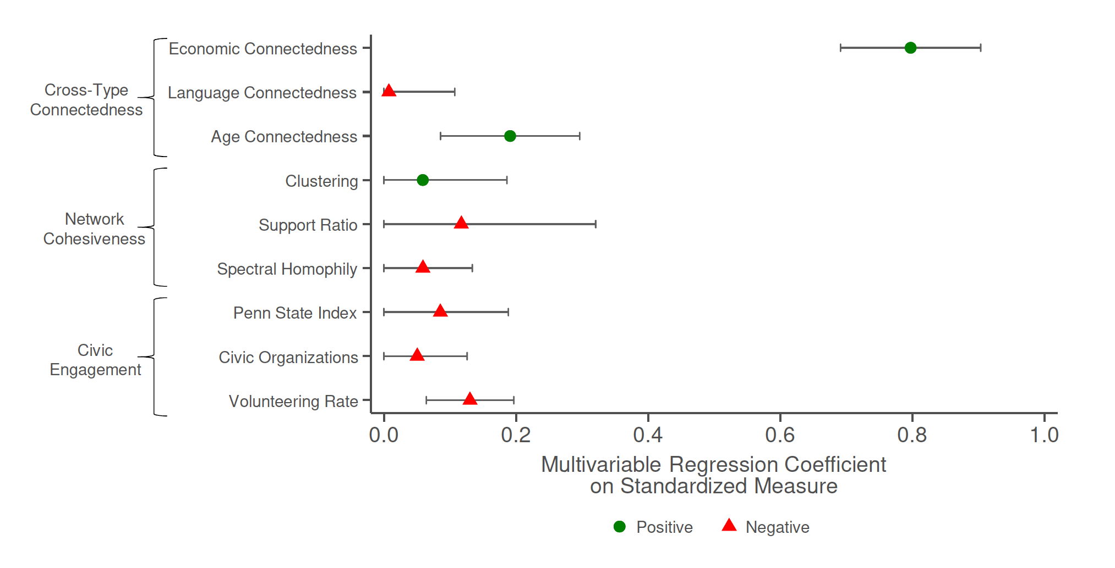
Correlations between Upward Mobility and Measures of Social Capital
Coefficients from County-level Multivariable Regression
Notes:
1-3B

Slide 5
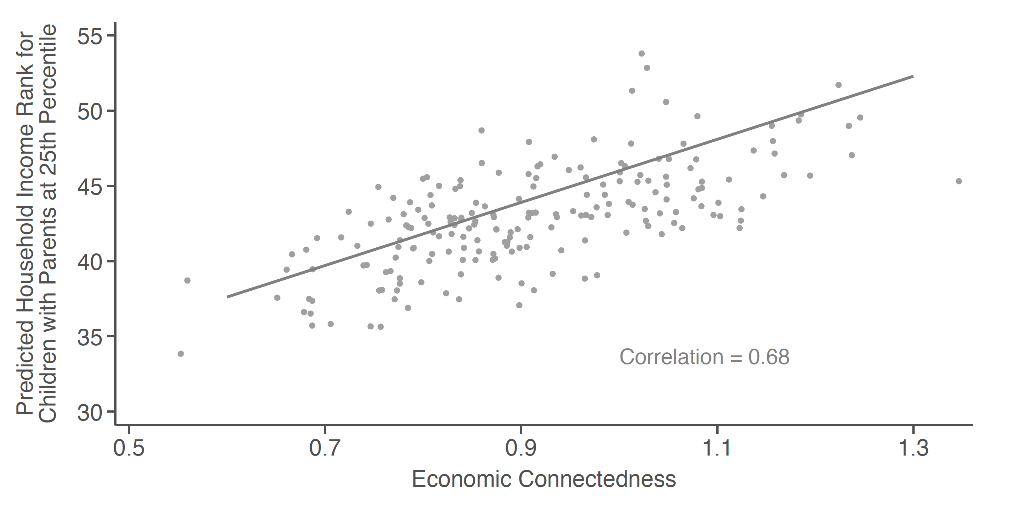
Selection on Race: Upward Mobility vs. EC in Counties with >90% White Residents
Notes:
1-SI-5B

Slide 6
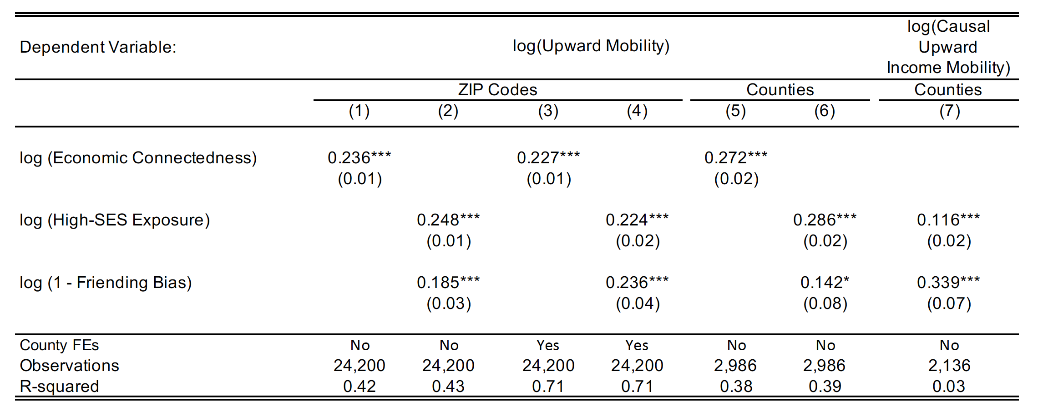
Associations between Friending Bias, Exposure, and Upward Mobility across Counties and ZIP Codes
Notes:
1-2

Slide 7
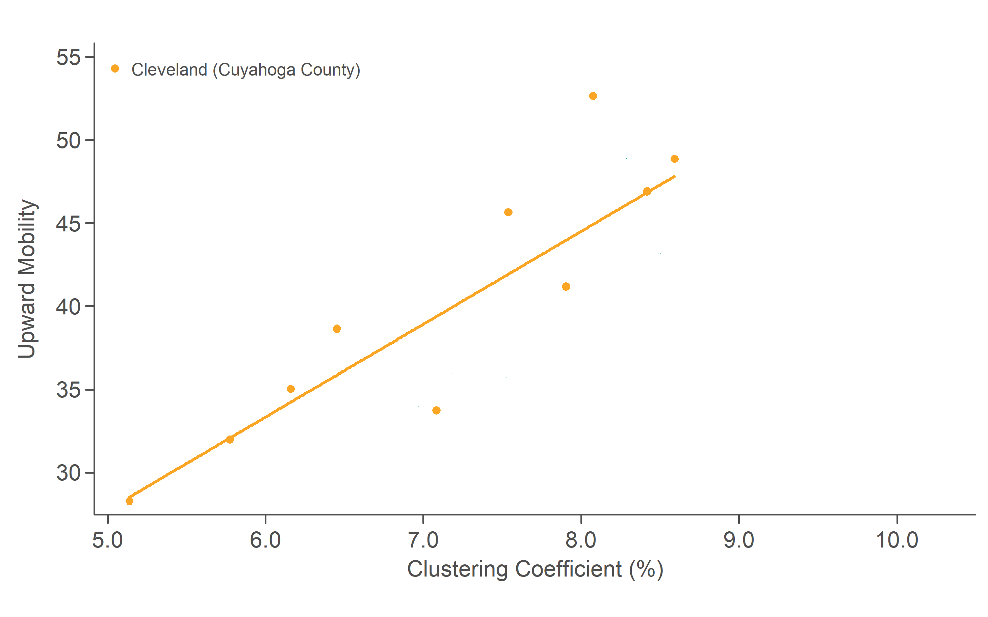
Relationship between Clustering and Upward Mobility
Across ZIP Codes for Four Counties in Ohio
Notes:
1-ED-4A

Slide 8
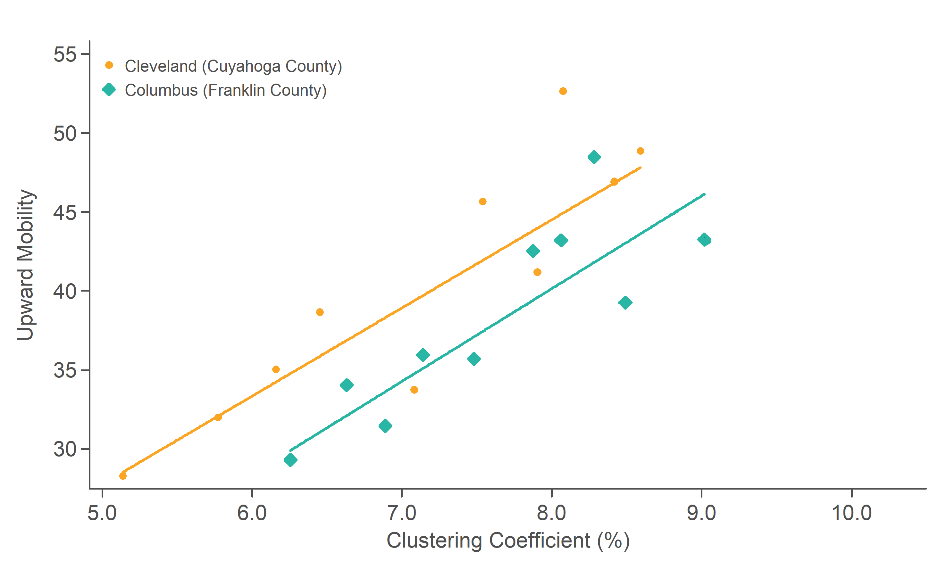
Relationship between Clustering and Upward Mobility
Across ZIP Codes for Four Counties in Ohio
Notes:
1-ED-4A

Slide 9
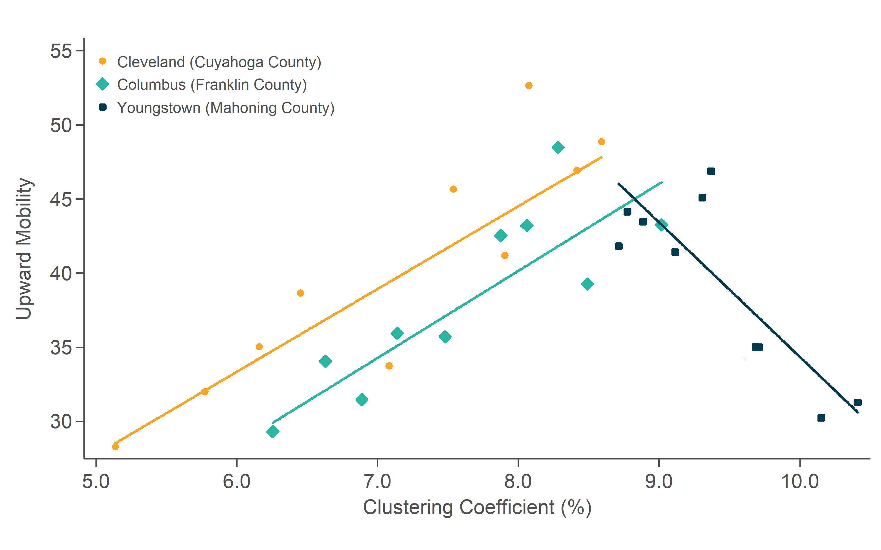
Relationship between Clustering and Upward Mobility
Across ZIP Codes for Four Counties in Ohio
Notes:
1-ED-4A

Slide 10
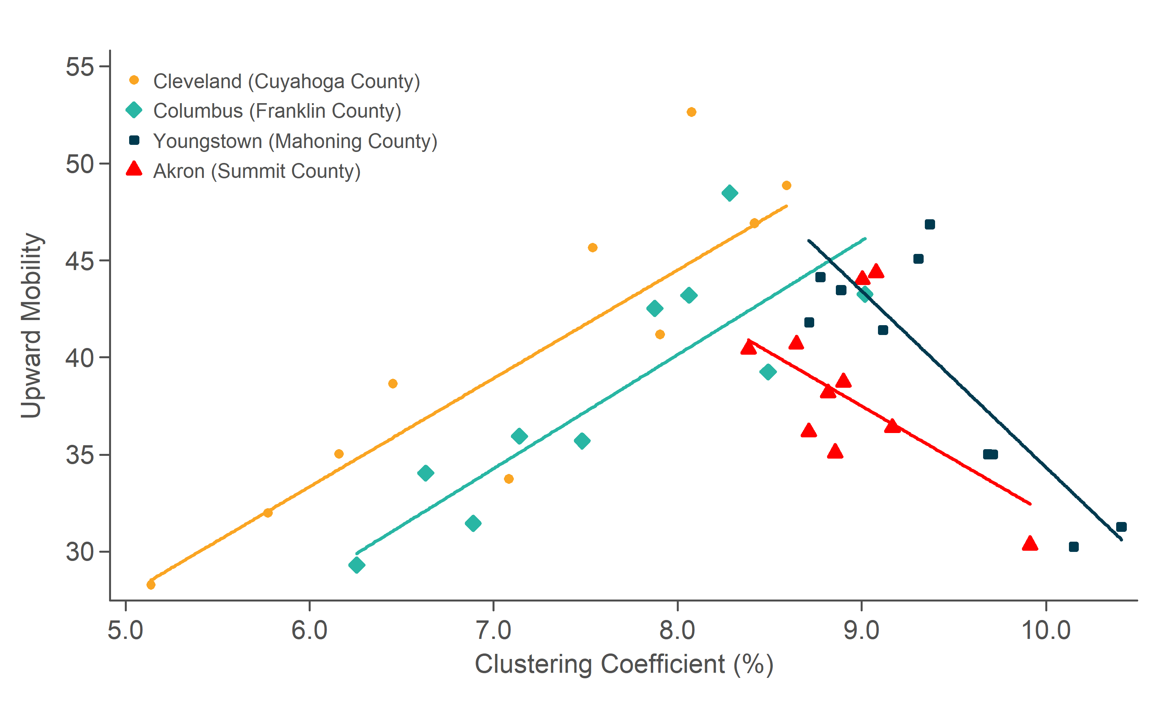
Relationship between Clustering and Upward Mobility
Across ZIP Codes for Four Counties in Ohio
Notes:
1-ED-4A

Slide 11
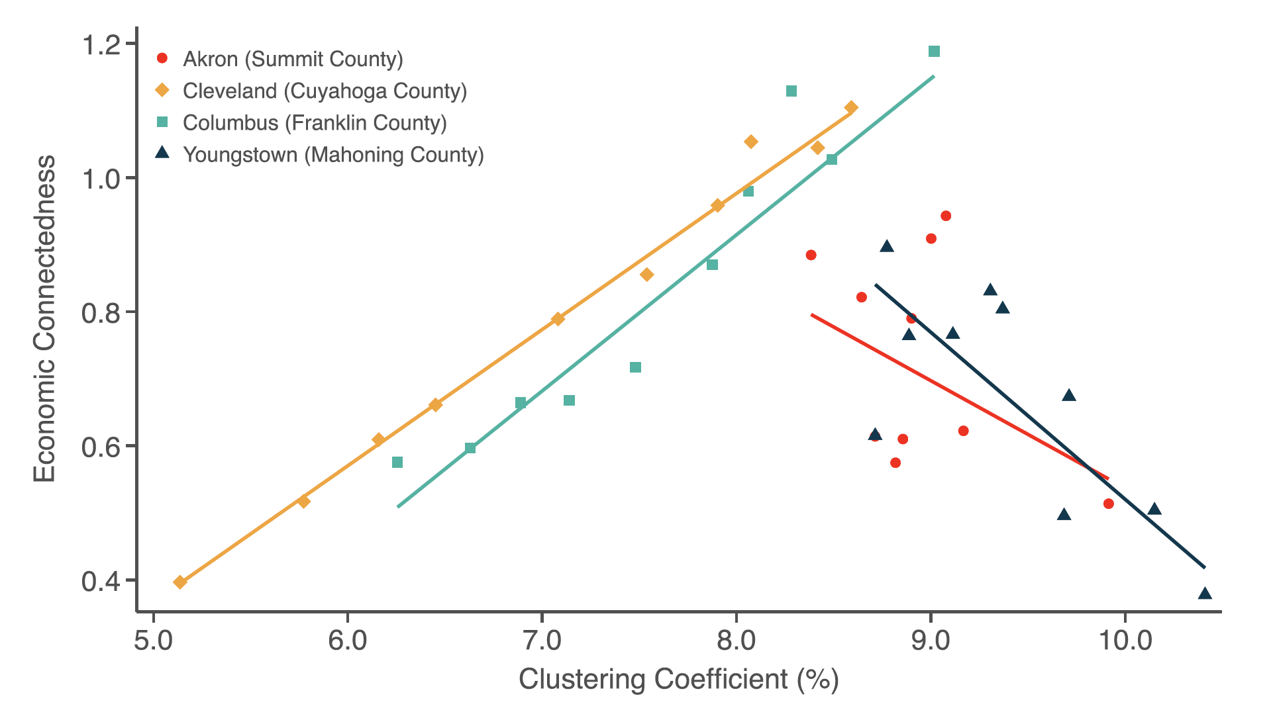
Relationship between Clustering and Economic Connectedness
Across ZIP Codes for Four Counties in Ohio
Notes:
1-ED-4A, C

Slide 12
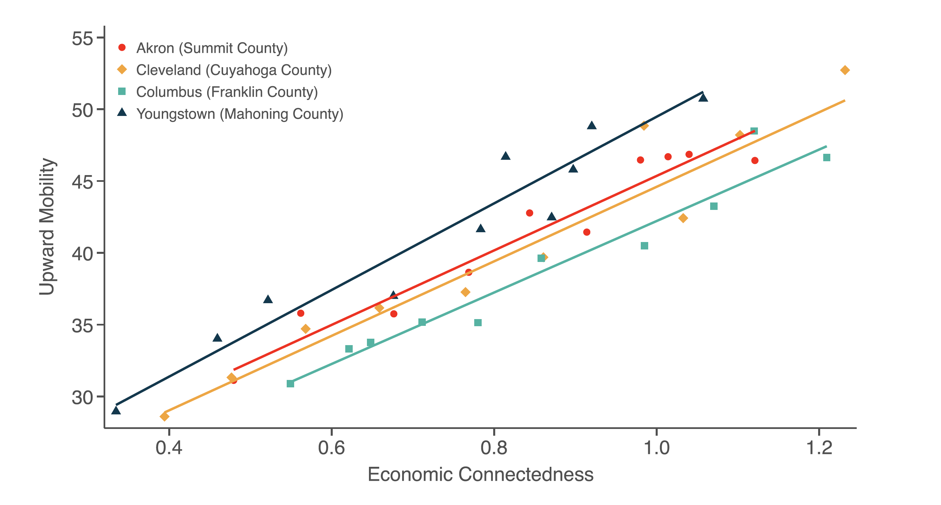
Relationship between Upward Mobility and Economic Connectedness
Across ZIP Codes for Four Counties in Ohio
Notes:
1-ED-4B

Slide 13
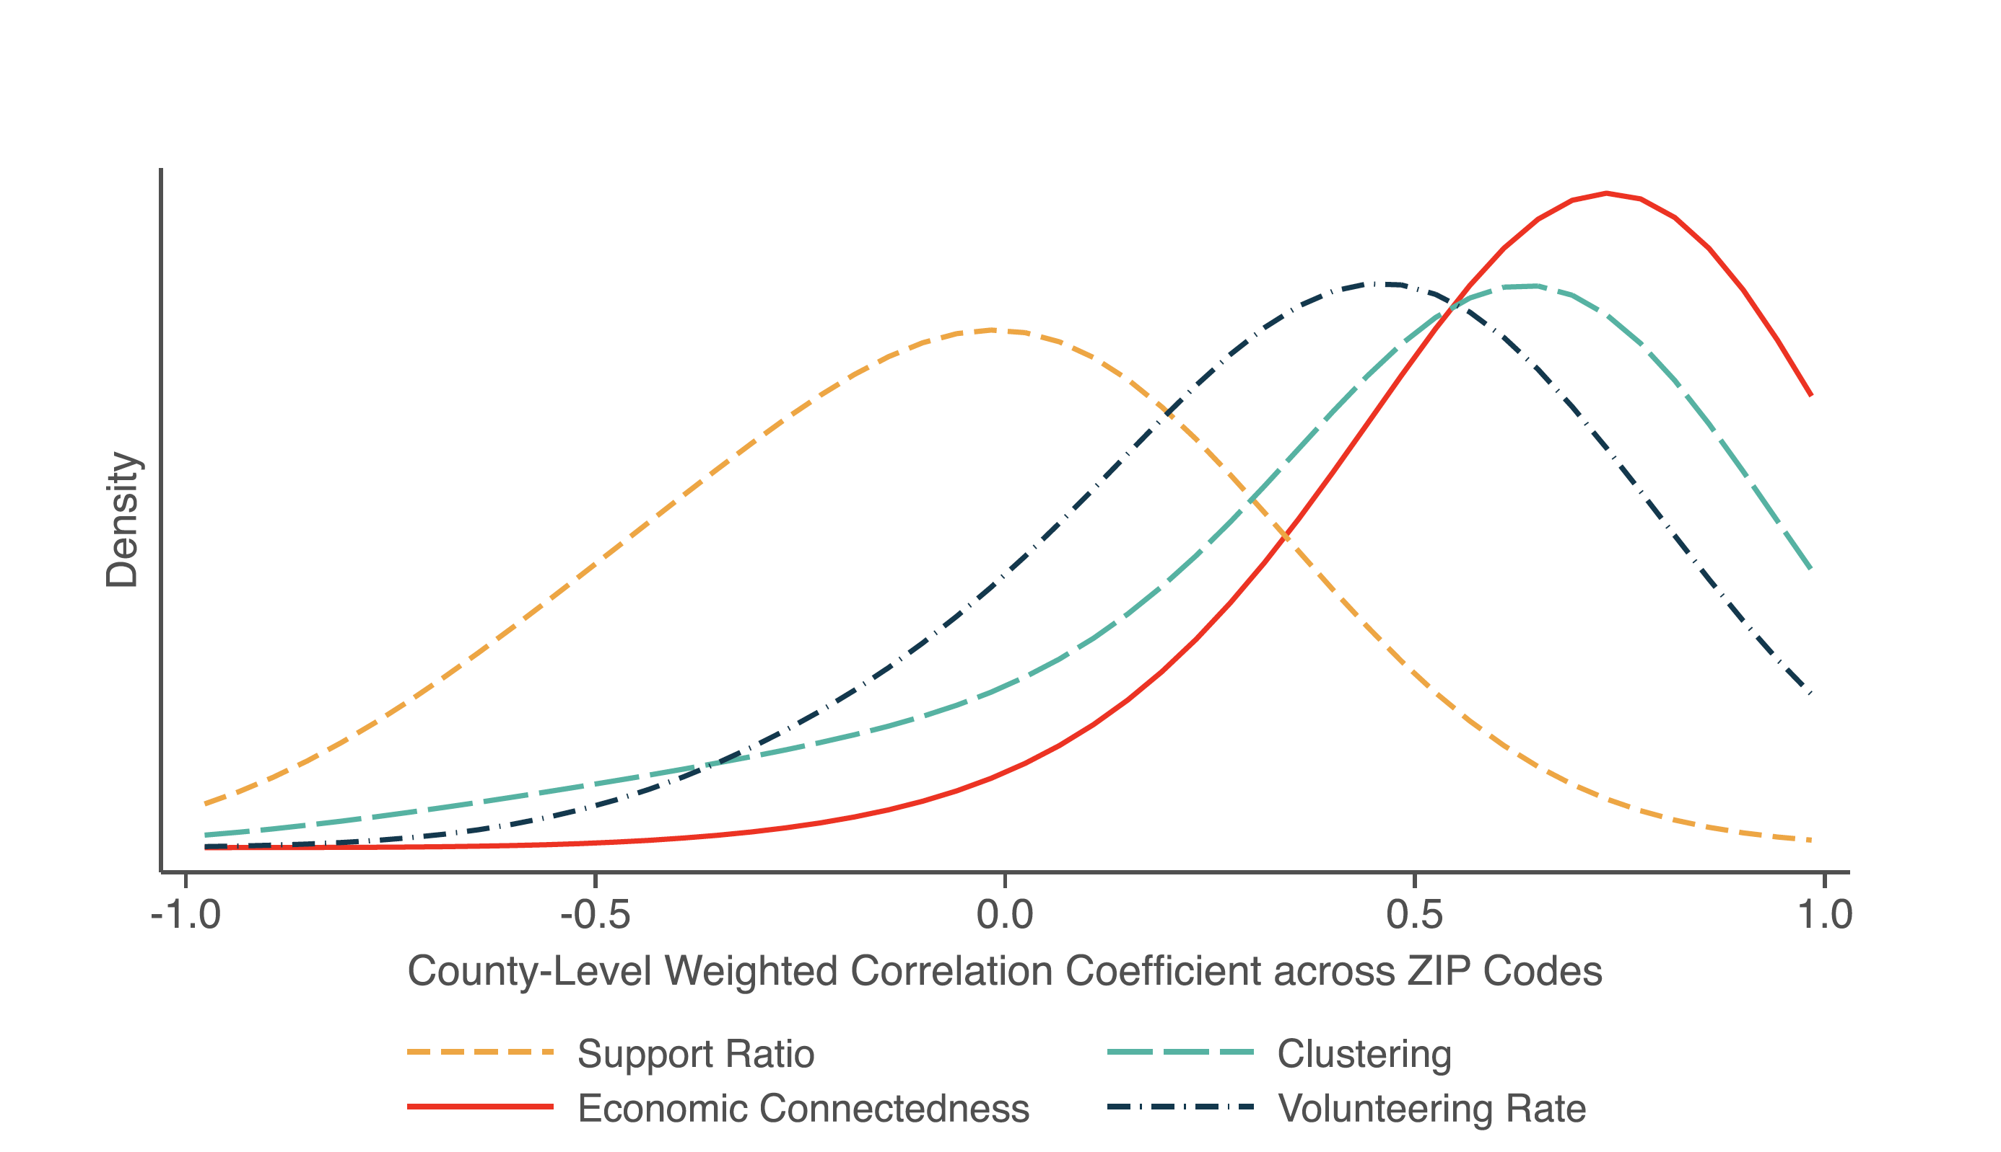
Distributions of ZIP Code-Level Correlations between Upward Mobility and Social Capital Measures across Counties
Notes:
1-ED-4D

Slide 14
Different Types of Social Capital Matter for Different Outcomes
Economic connectedness may predict upward mobility because it provides “bridging” social capital useful for “getting ahead” [Putnam 2000]
But important to recognize that it is not necessarily the “best” measure of social capital in general
Illustrate by looking at correlations with other outcomes, such as life expectancy by income

Slide 15
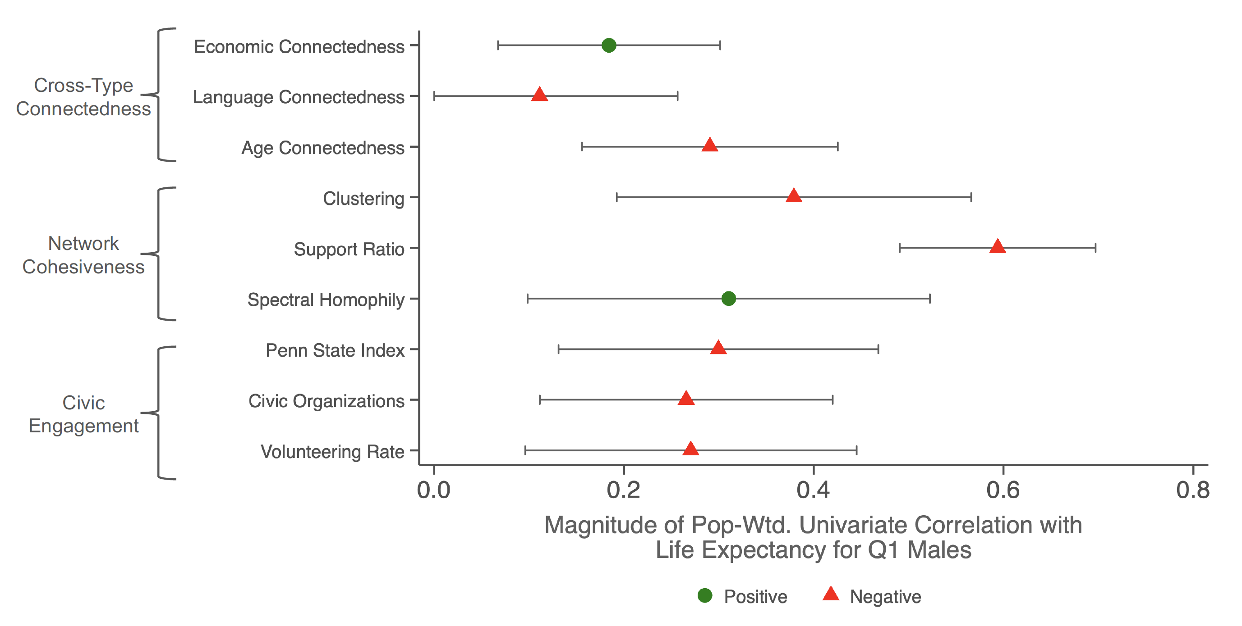
Correlations between Social Capital and Life Expectancy at Age 40 for Bottom-Income-Quartile Men
Univariate County-level Correlations
Notes:
1-SI-11A

Slide 16
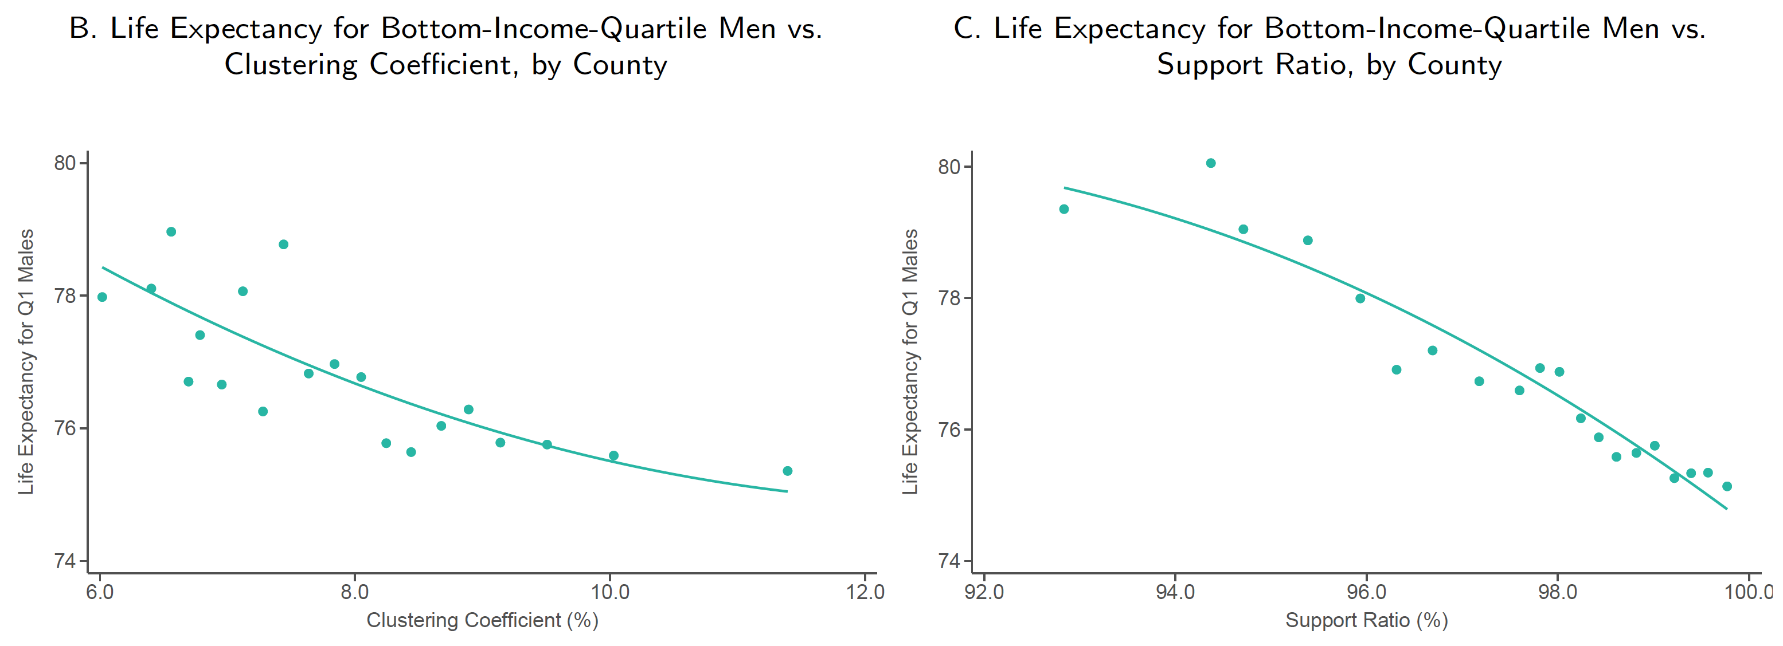
Correlations between Social Capital and Life Expectancy at Age 40 for Bottom-Income-Quartile Men
Cohesiveness vs. Life Expectancy
Notes:
1-SI-11B, C

Slide 17
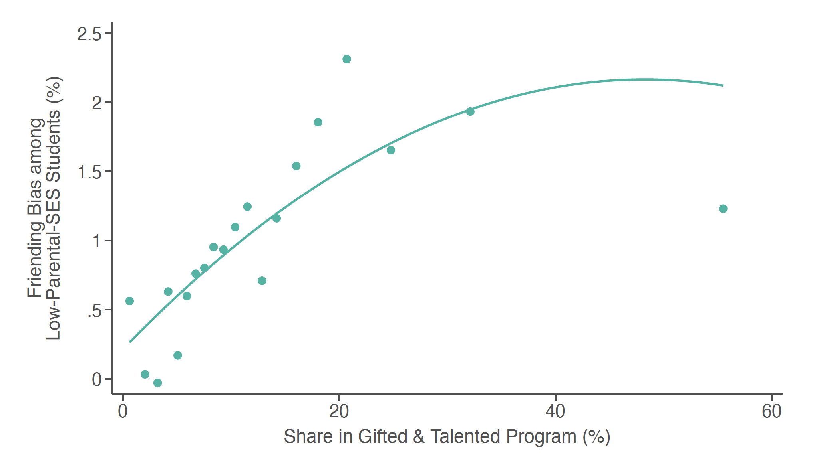
Friending Bias in High Schools vs. Gifted & Talented Enrollment
Bias Measured using Parental SES
Notes:
2-ED-1B

Slide 18
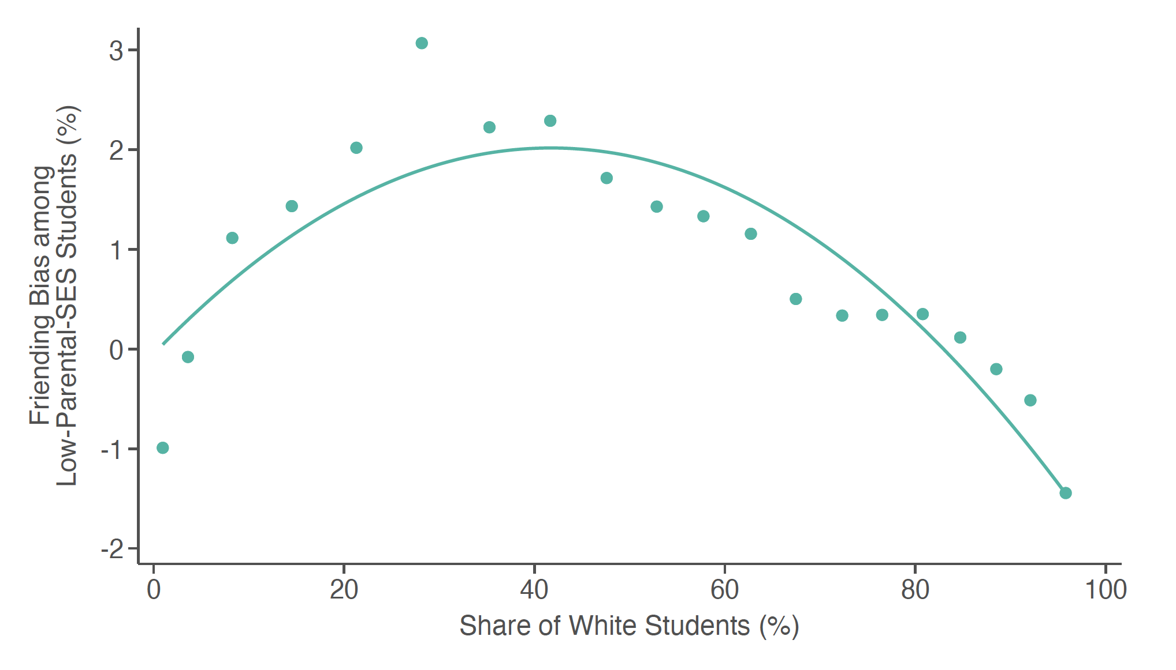
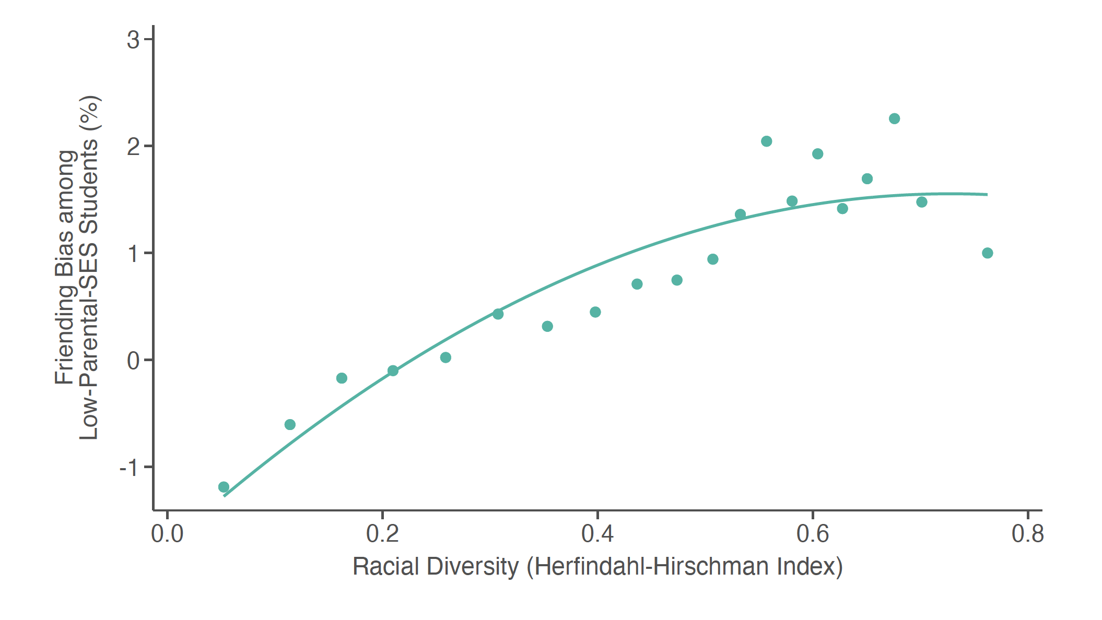
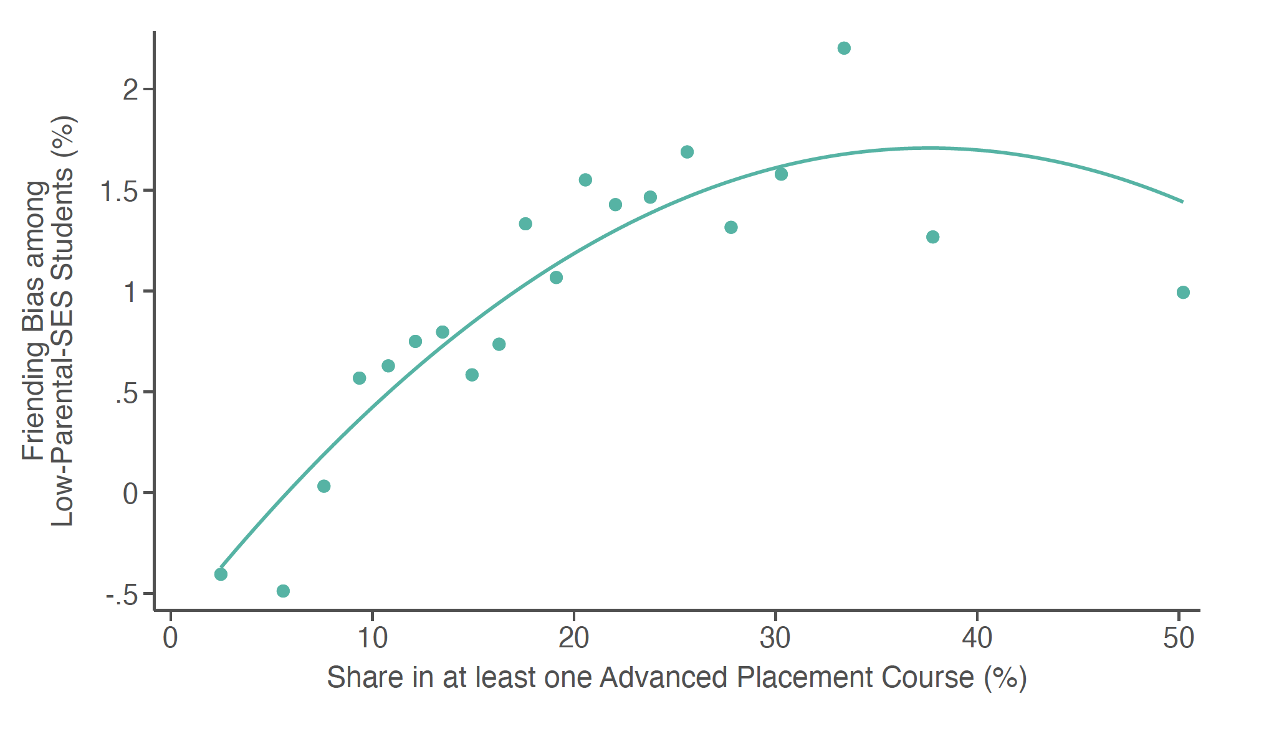
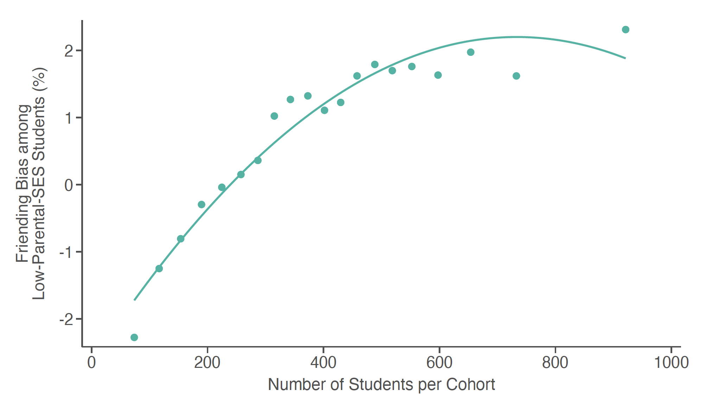
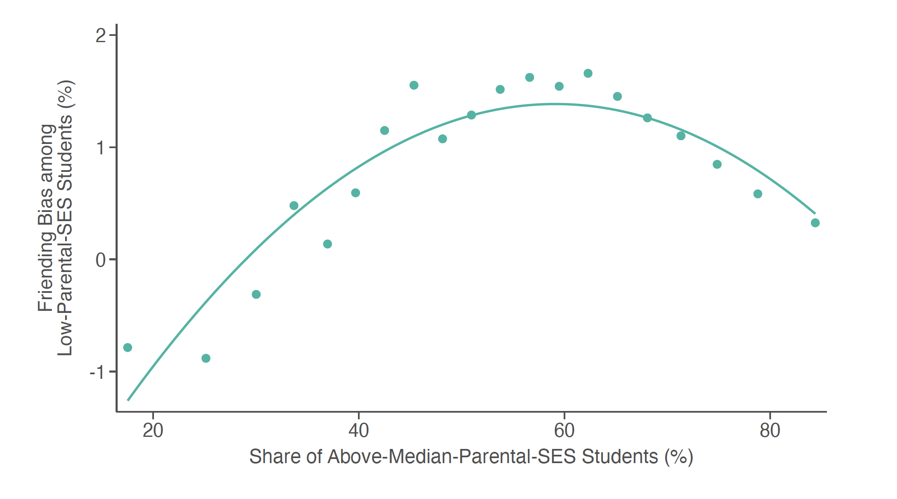
Friending Bias in High Schools vs. Share of White Students
Bias Measured using Parental SES
Notes:
2-ED-1F

Slide 19
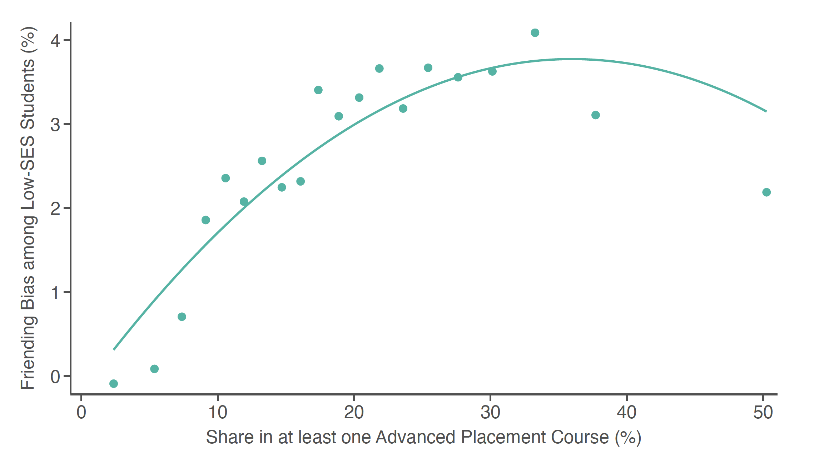
Friending Bias in High Schools vs. AP Enrollment
Bias Measured using Own SES
Notes:
2-ED-2A

Slide 20
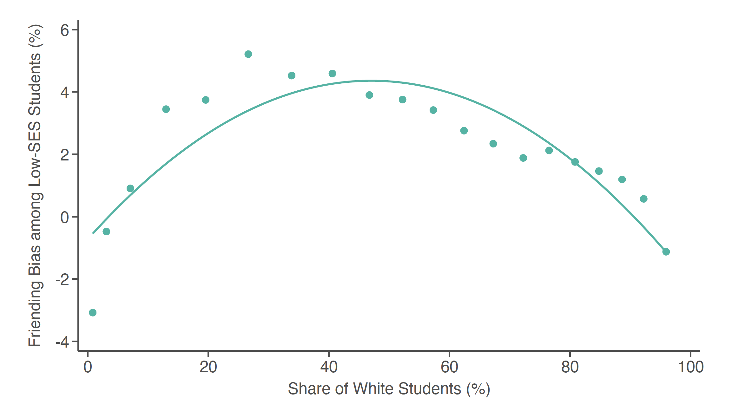
Friending Bias in High Schools vs. Share of White Students
Bias Measured using Own SES
Notes:
2-ED-2F

Slide 21
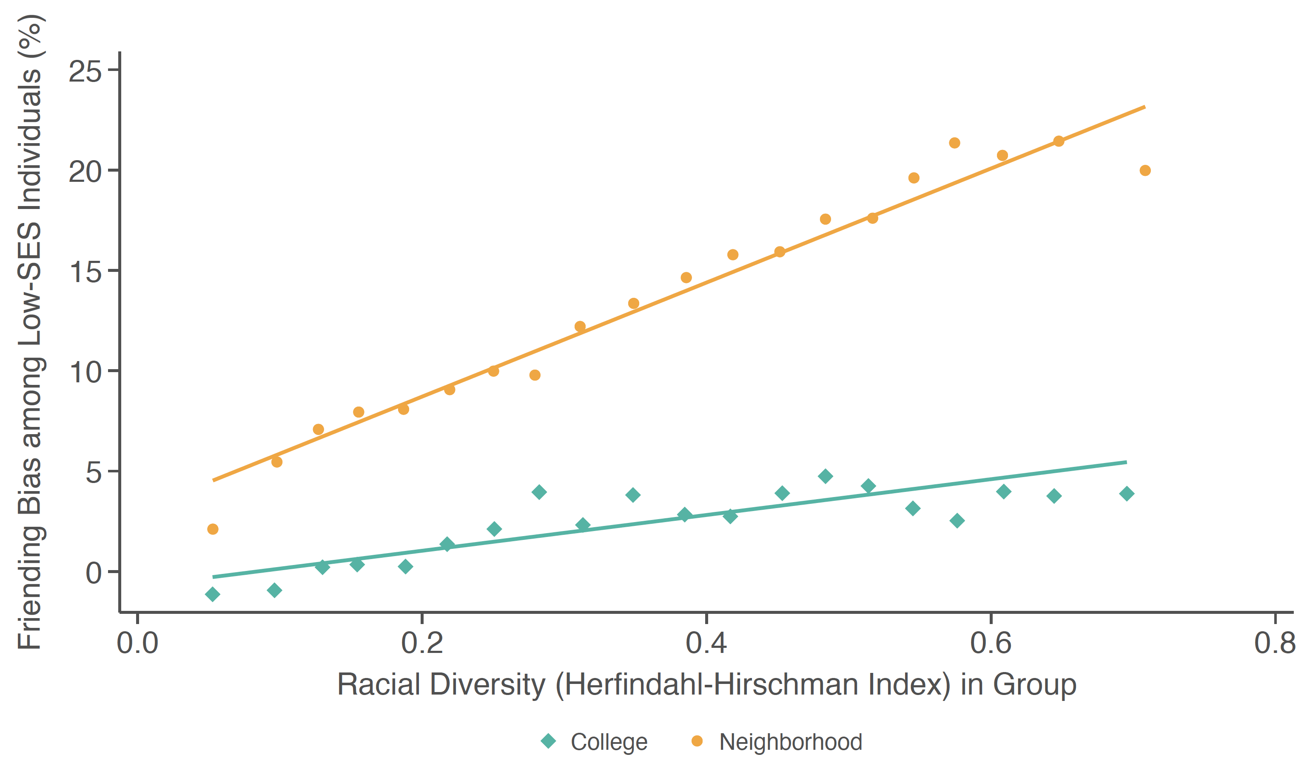
Racial Diversity vs. Friending Bias
In Colleges and Neighborhoods
Notes:
2-ED-3

Slide 22
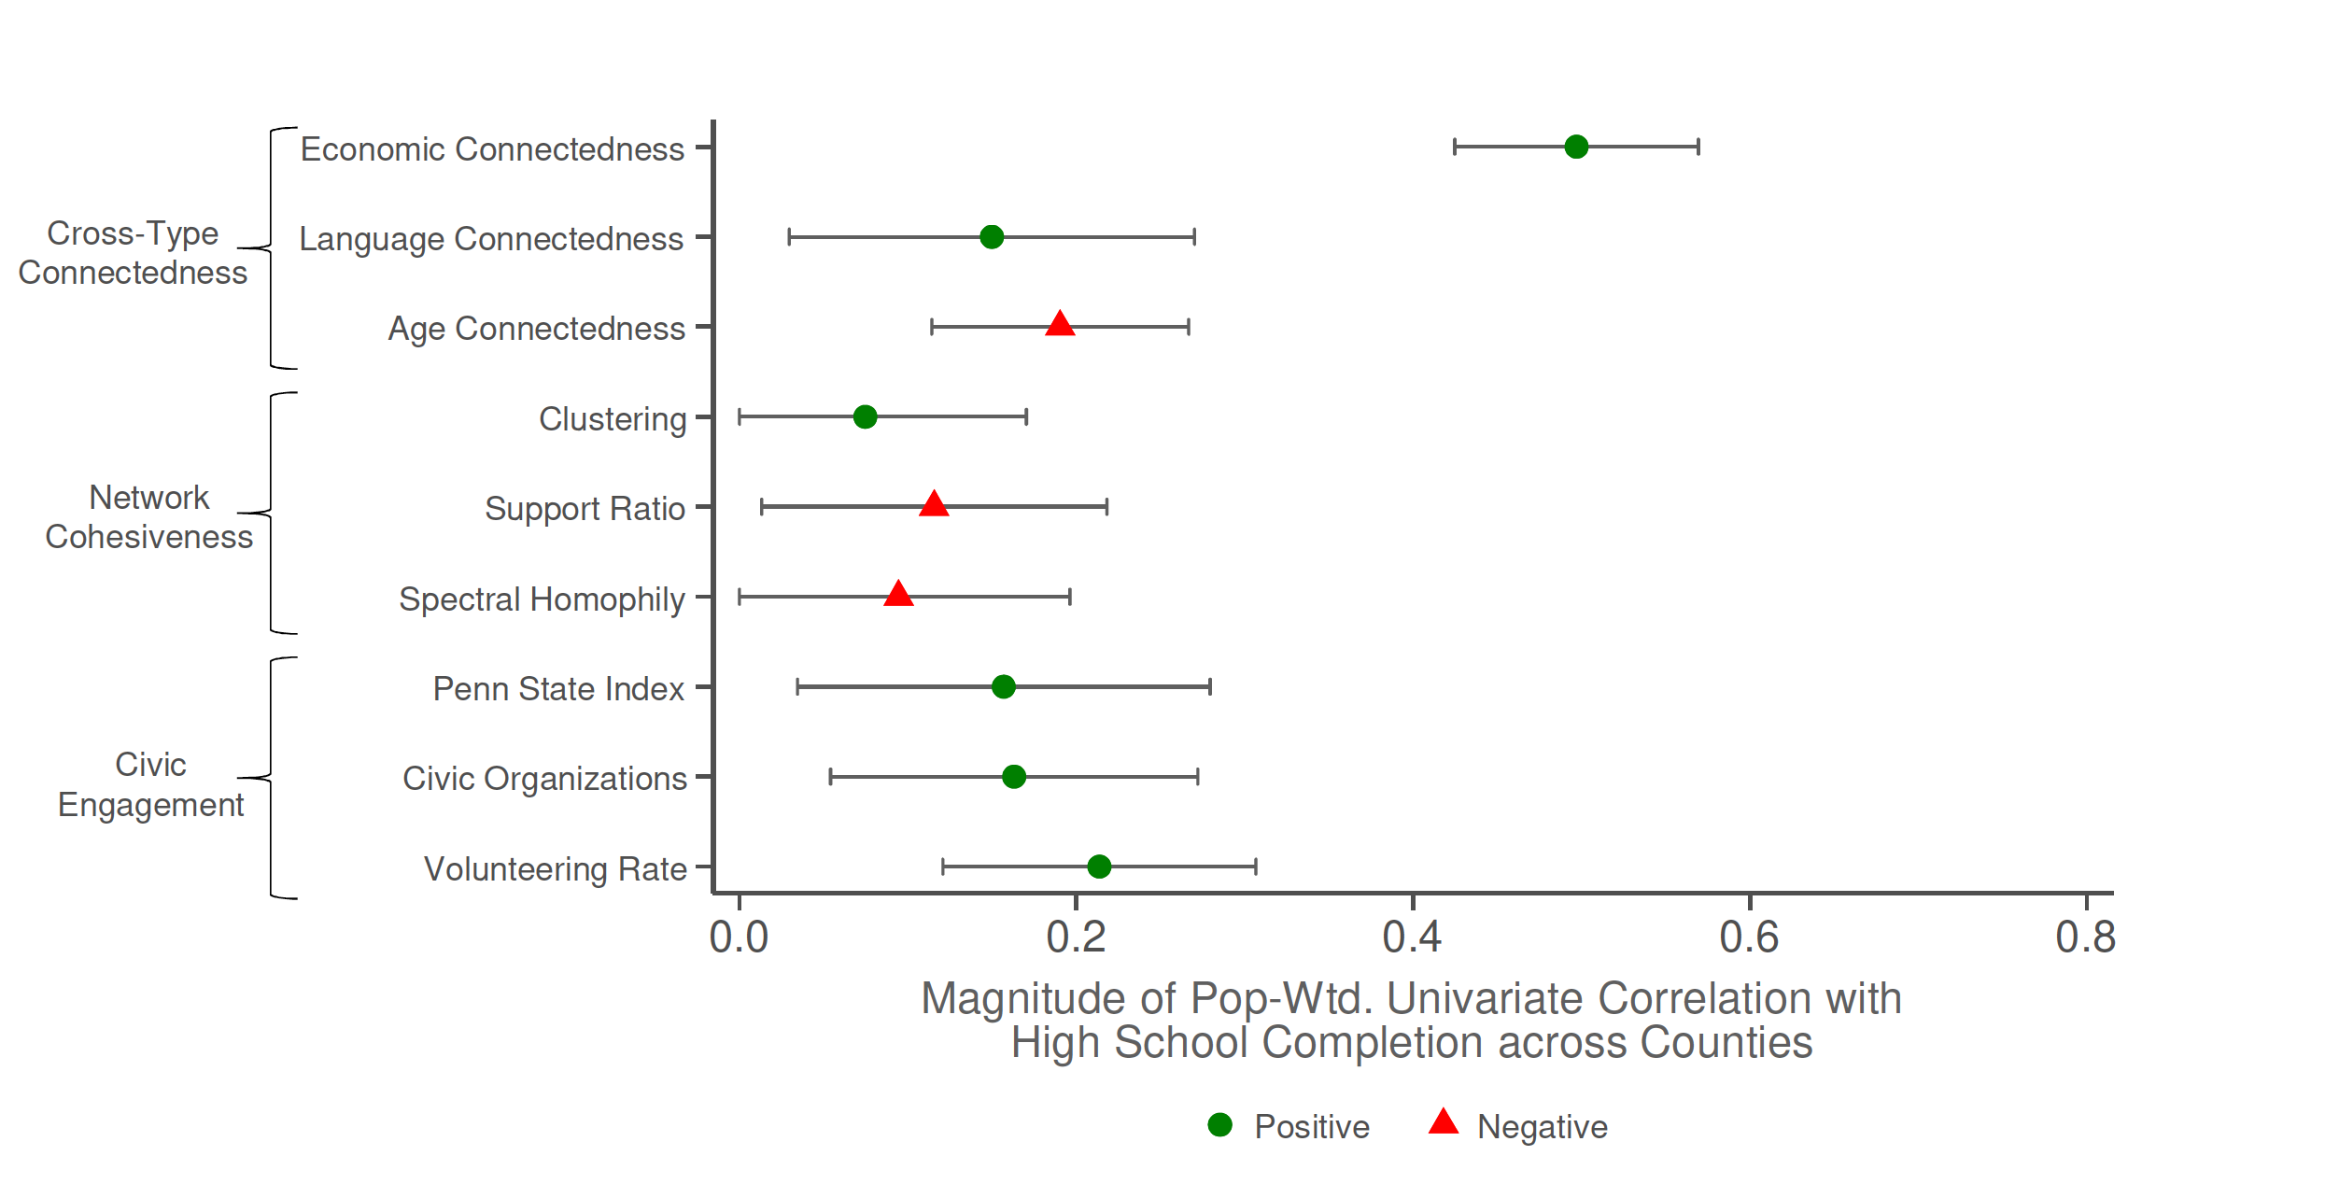
Correlations with
High School Completion Rate for Children with Parents at 25th Percentile
Notes:
1-ED-3A

Slide 23
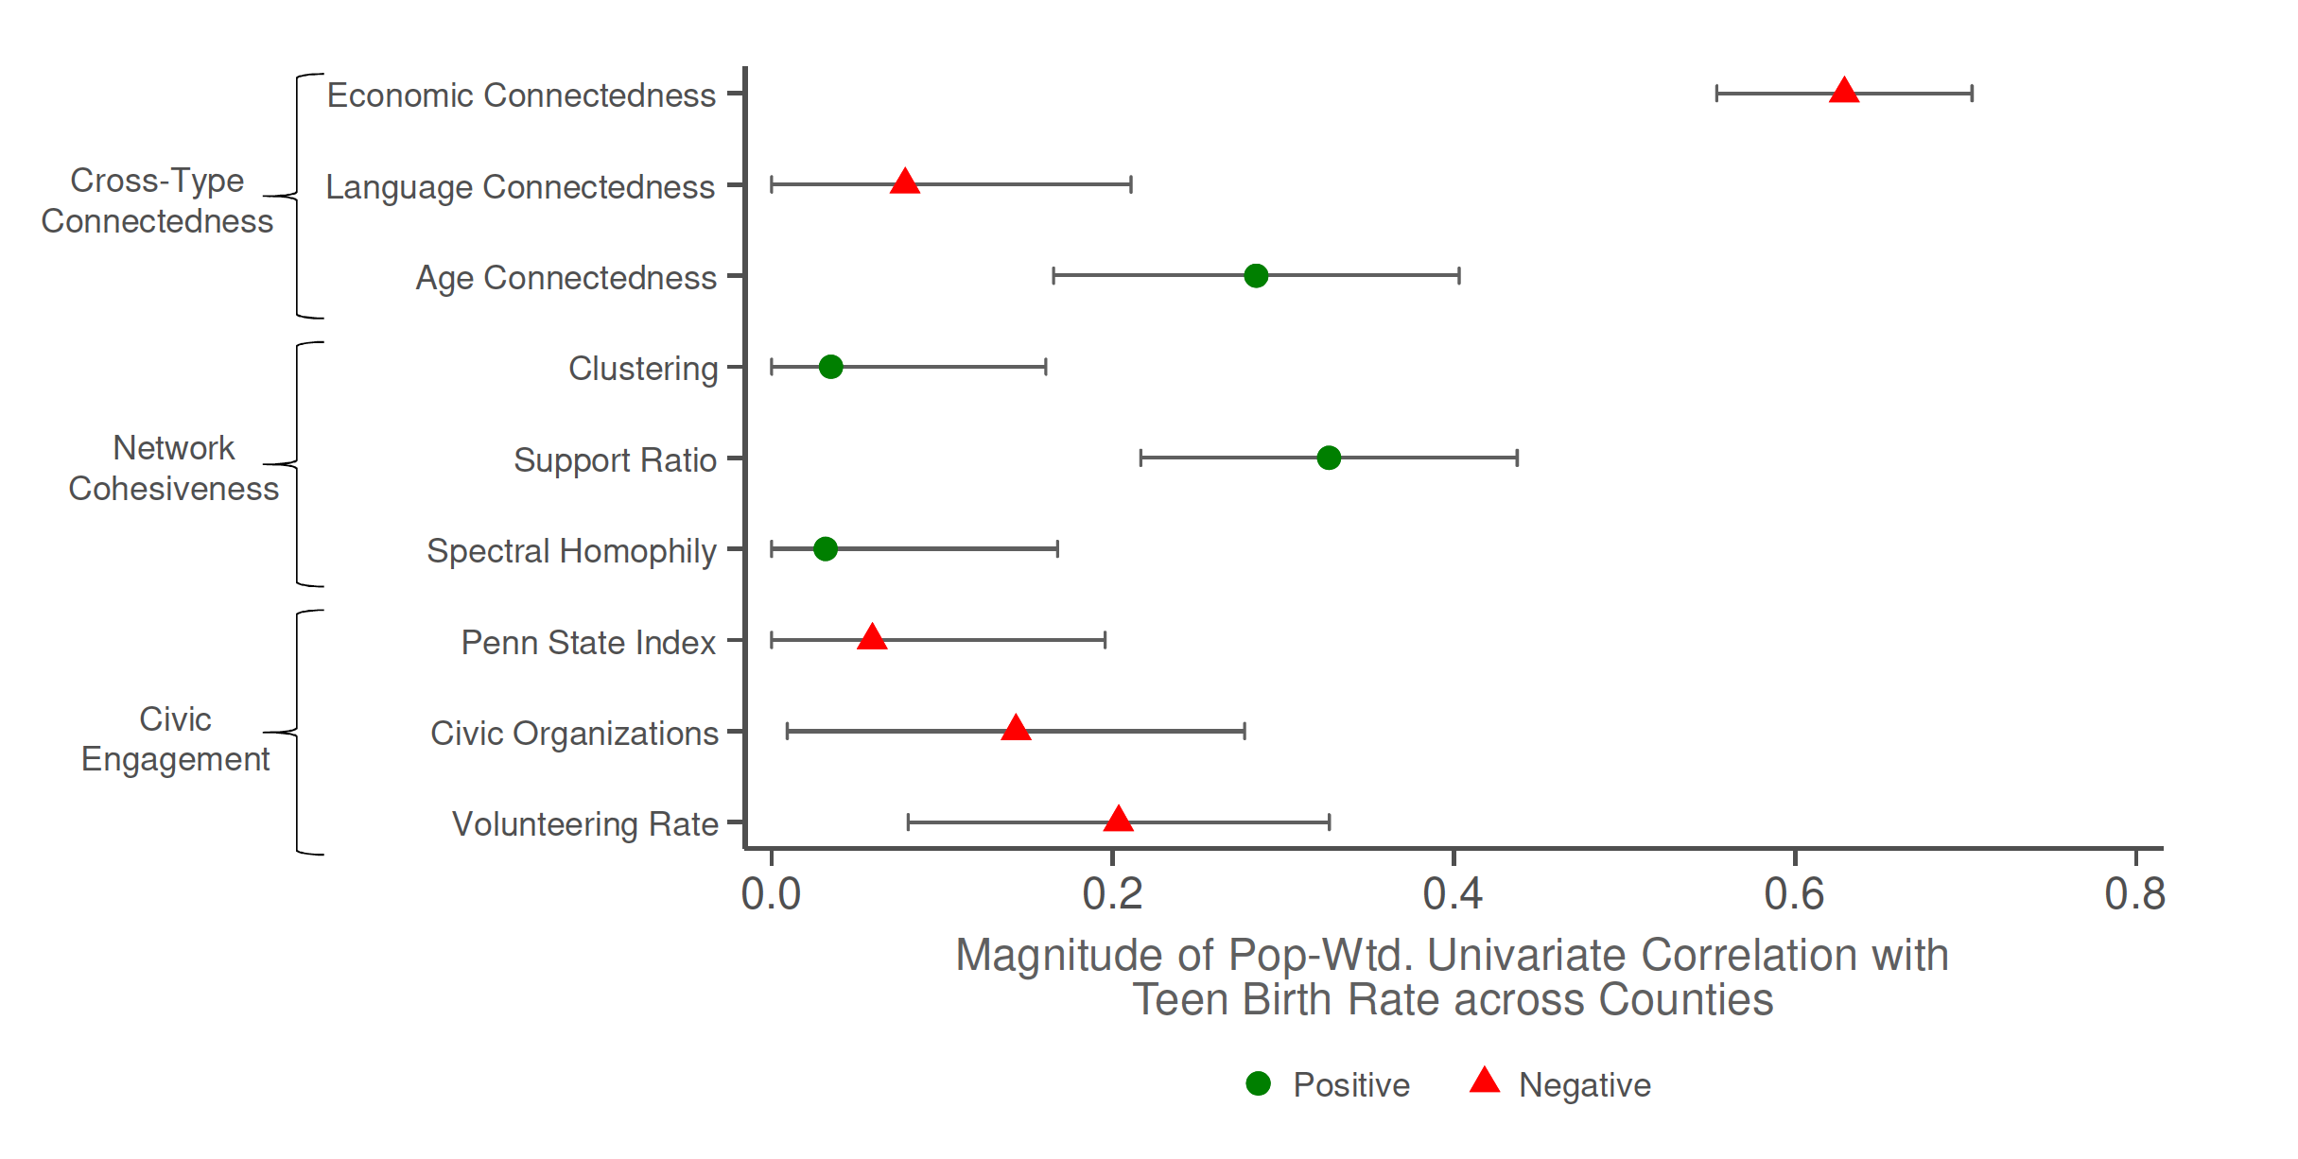
Correlations with
Teen Birth Rate for Women with Parents at 25th Percentile
Notes:
1-ED-3B

Slide 24
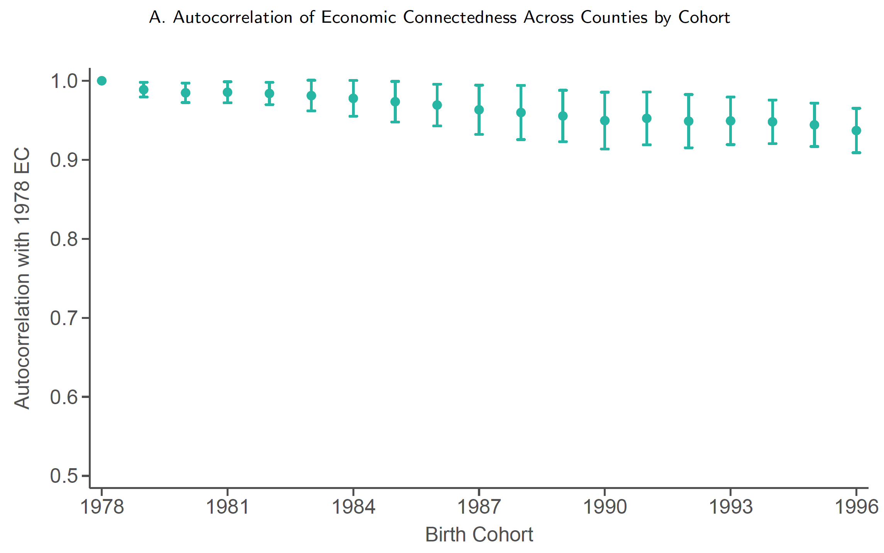
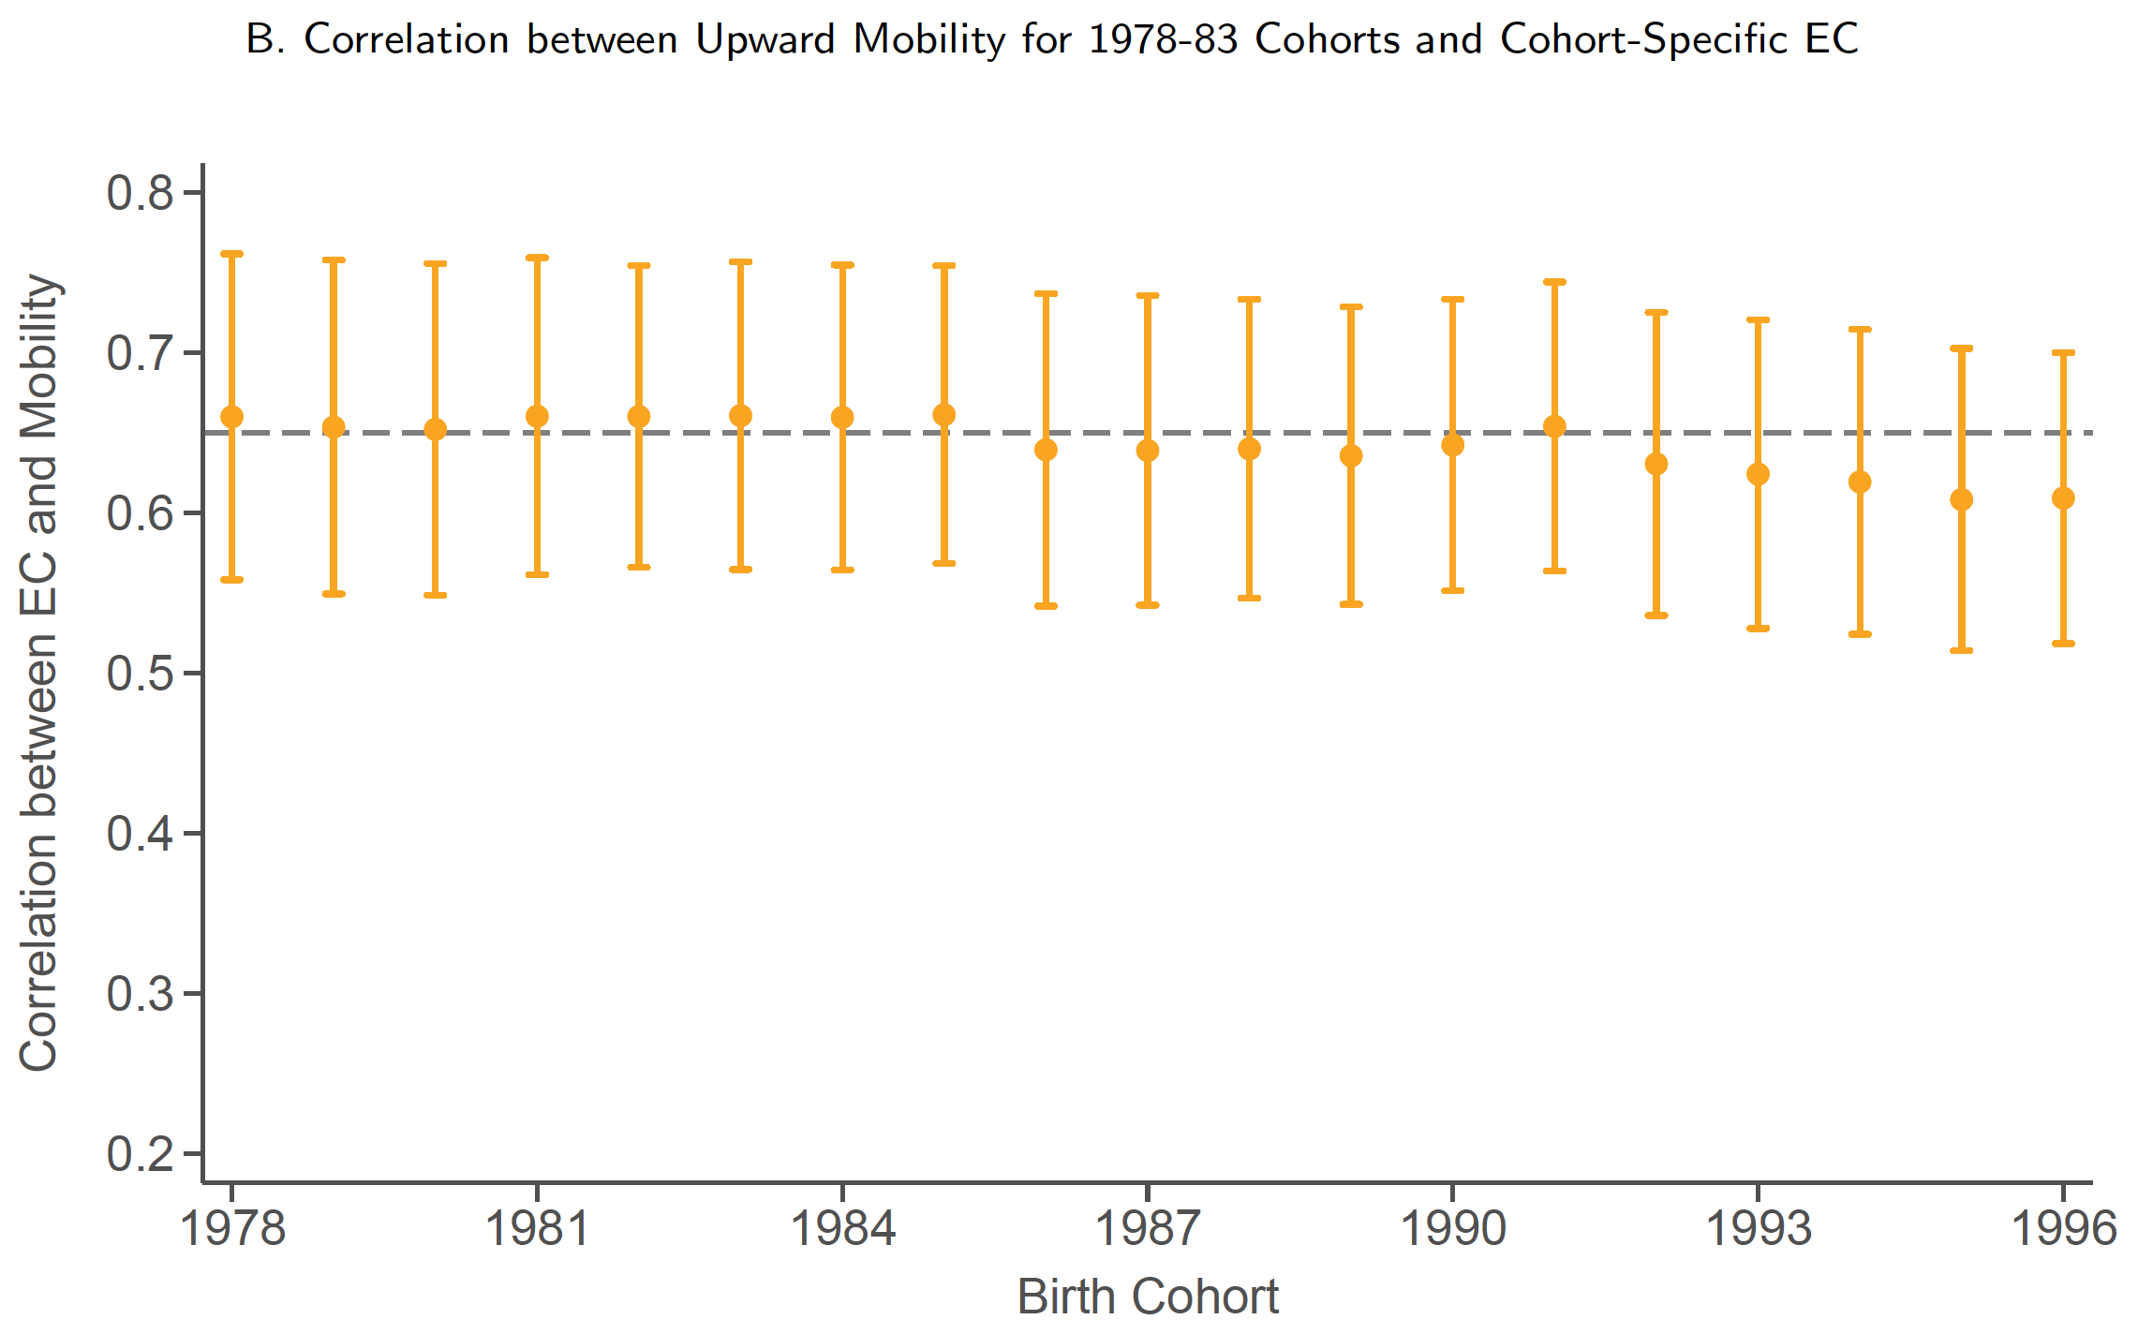
Stability of County-Level Economic Connectedness Across Cohorts
Notes:
1-SI-1A, B

Slide 25
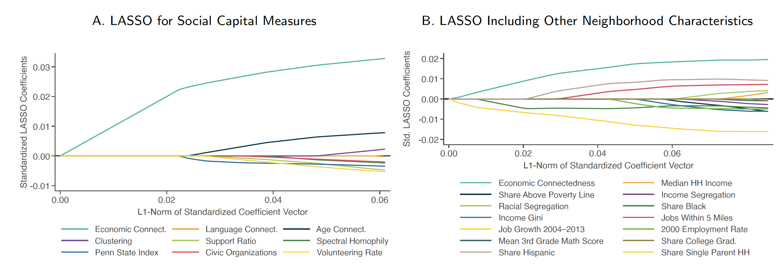
LASSO Estimates
Notes:
1-SI-2A, B

Slide 26
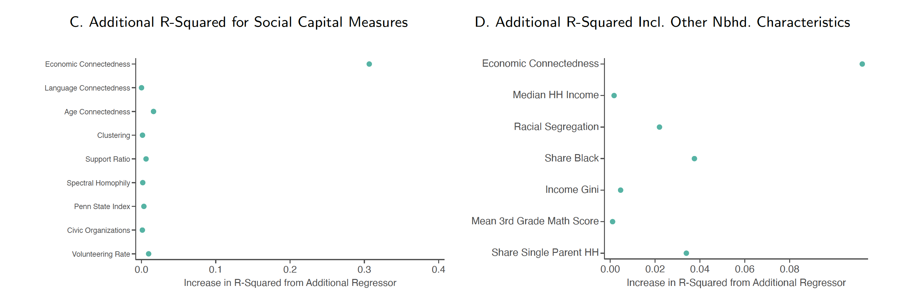
Incremental R-Squared of Predictors
Notes:
1-SI-2C, D

Slide 27
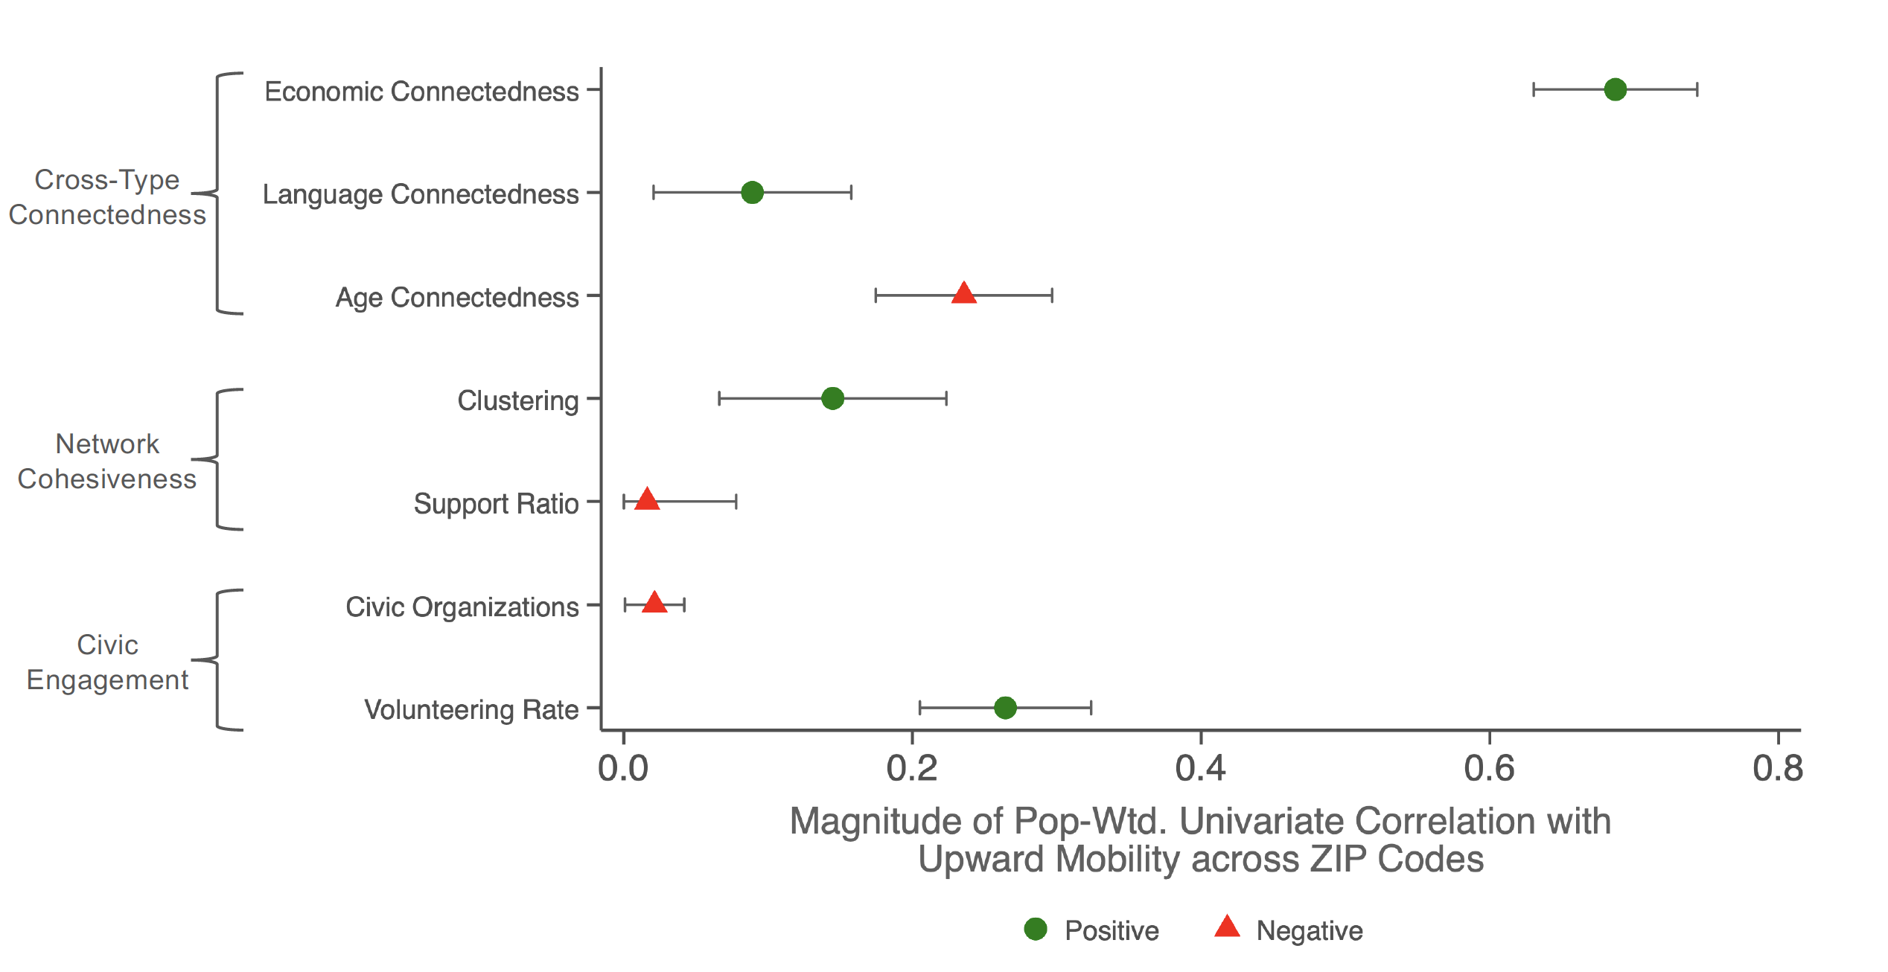
Correlations between Upward Mobility and Measures of Social Capital
ZIP-level Univariate Correlations
Notes:
1-SI-3A

Slide 28
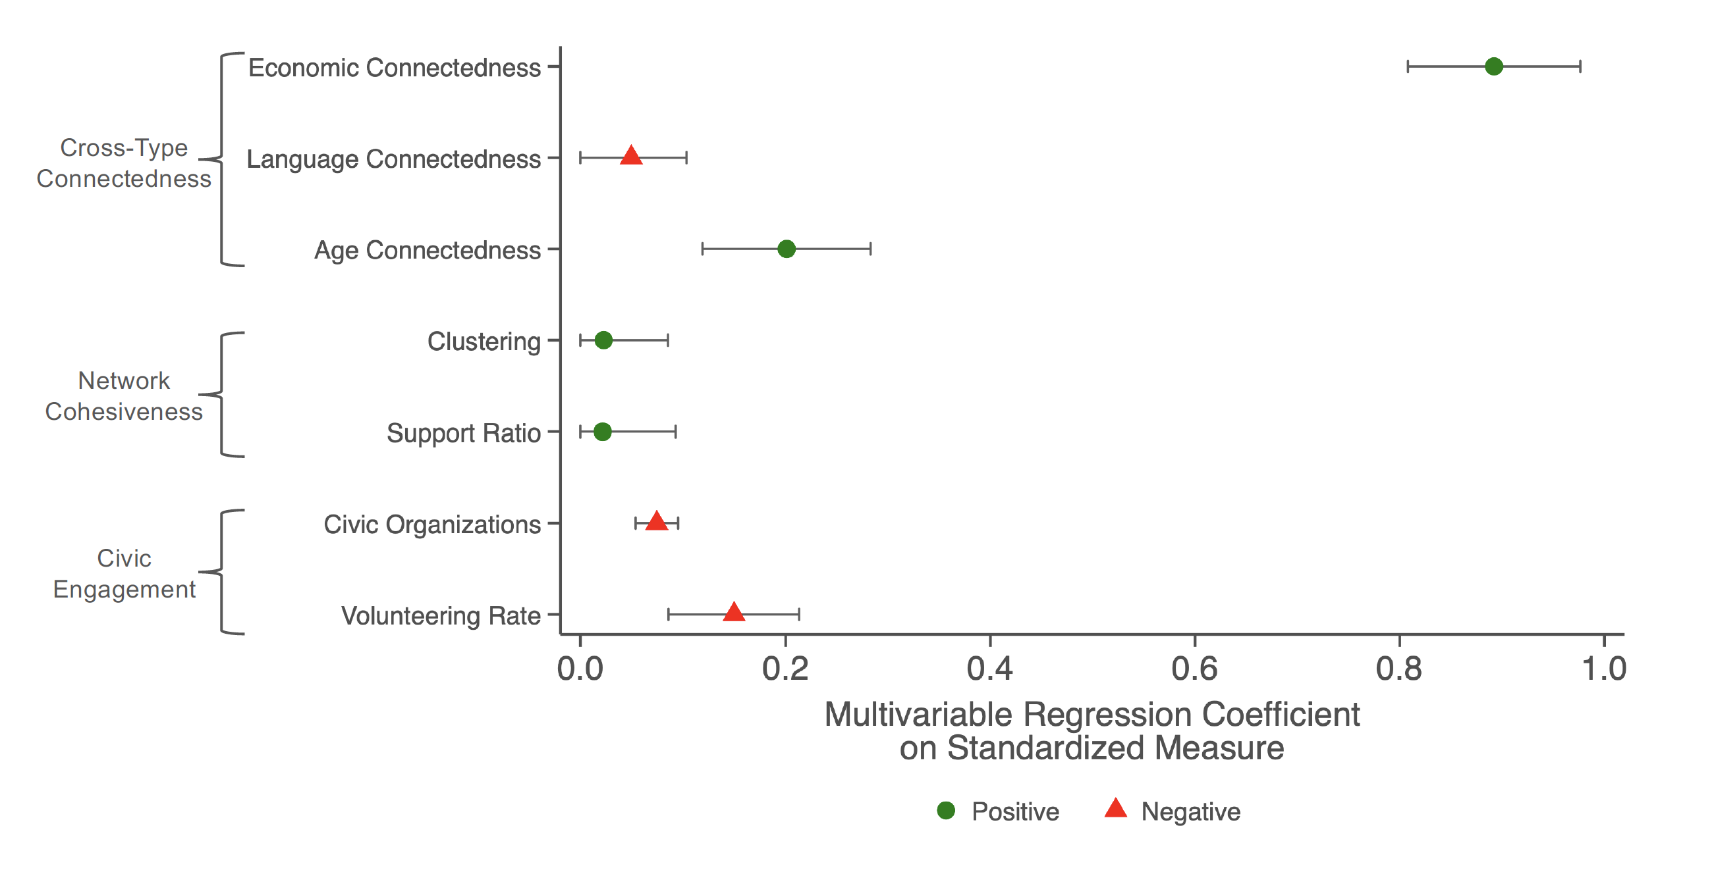
Correlations between Upward Mobility and Measures of Social Capital
Coefficients from ZIP-level Multivariable Regression
Notes:
1-SI-3B

Slide 29
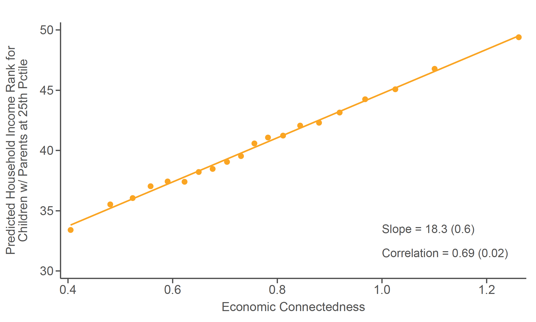
Relationship between Upward Mobility and EC
ZIP-level Regression
Notes:
1-SI-4A

Slide 30
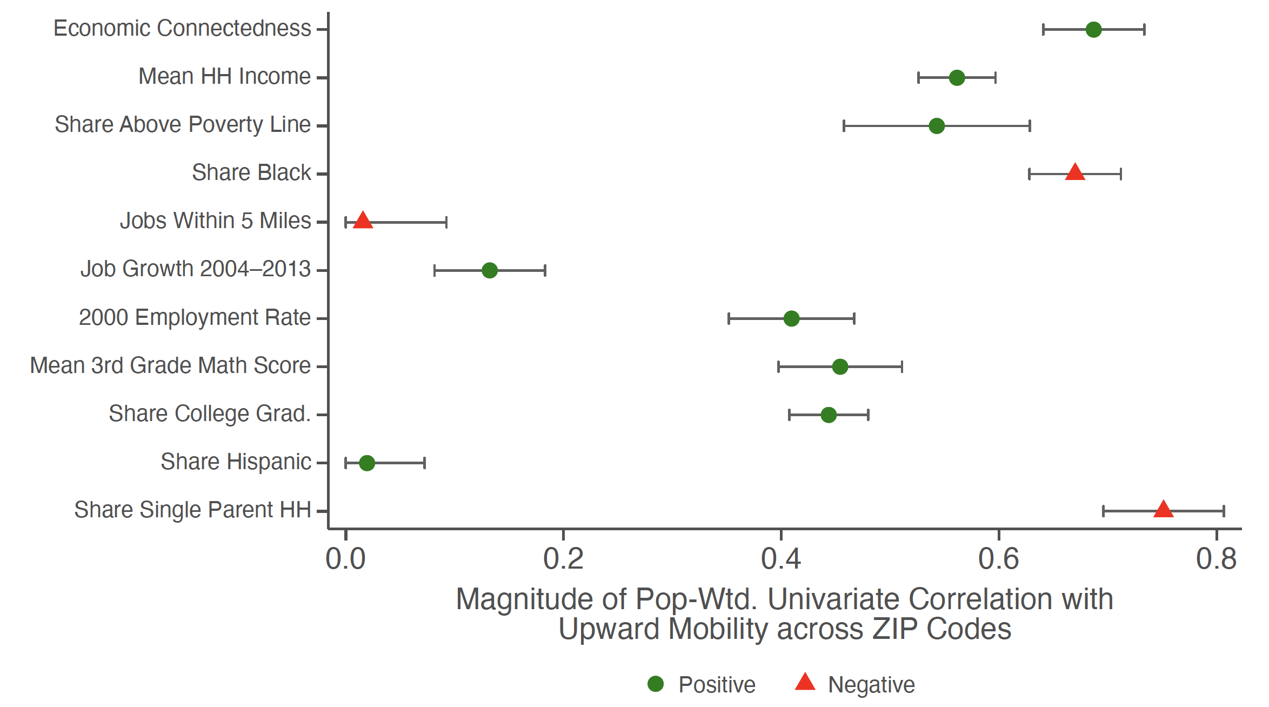
Relationship between Upward Mobility and EC
ZIP-level Univariate Correlations
Notes:
1-SI-4B

Slide 31
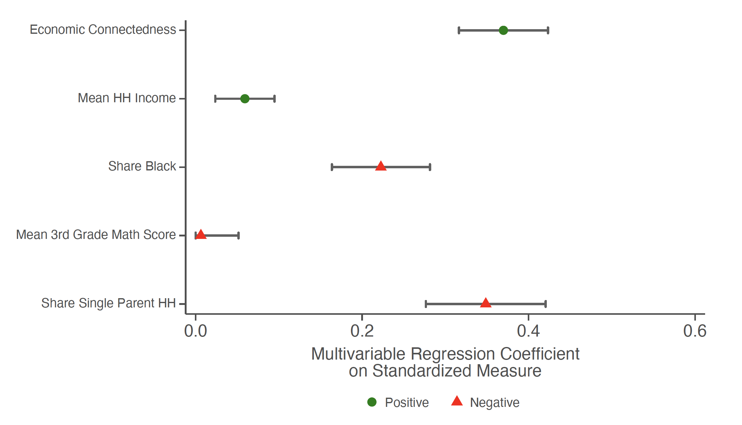
Relationship between Upward Mobility and EC
Coefficients from ZIP-level Multivariate Regression
Notes:
1-SI-4C

Slide 32
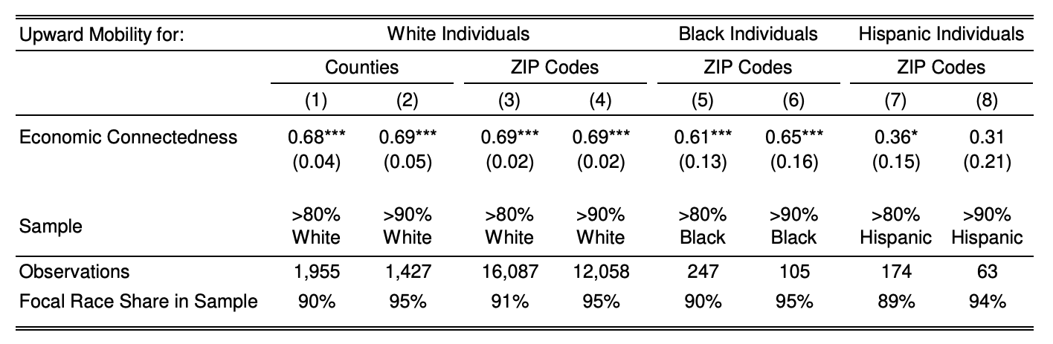
Associations between Race-Specific Upward Income Mobility and Economic Connectedness
Racially Homogeneous Areas
Notes:
1-ED-3

Slide 33
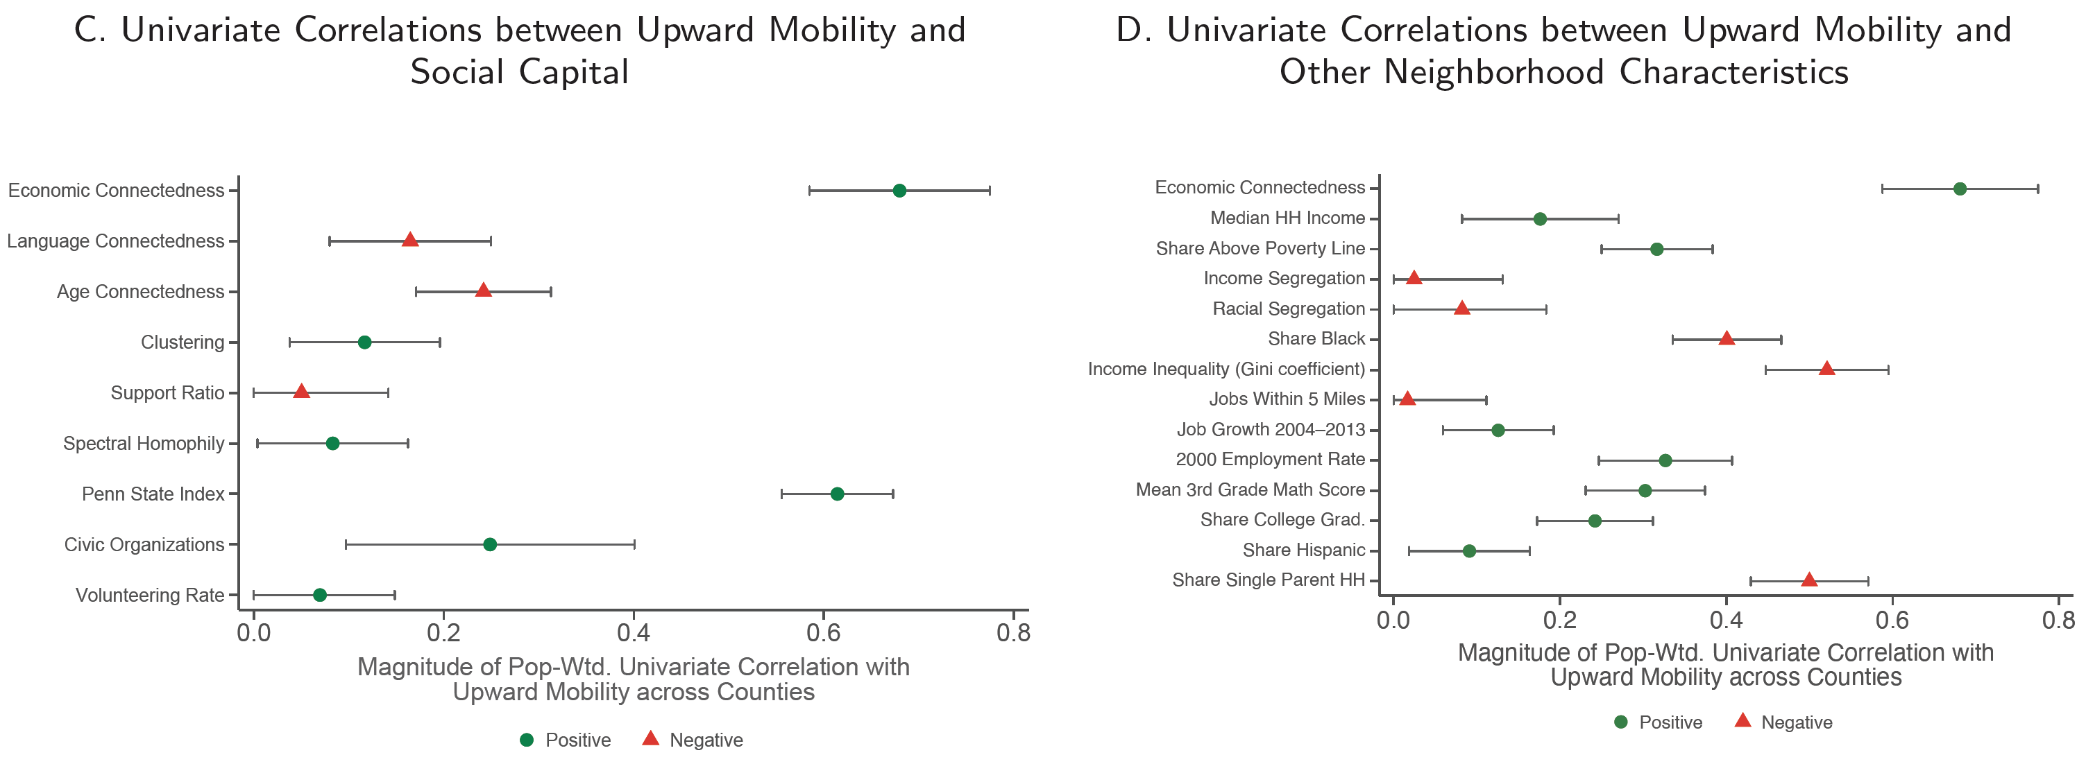
Social Capital and Upward Mobility in Counties with Predominantly White Residents
Univariate Correlations with Upward Mobility
Notes:
1-SI-5C, D

Slide 34
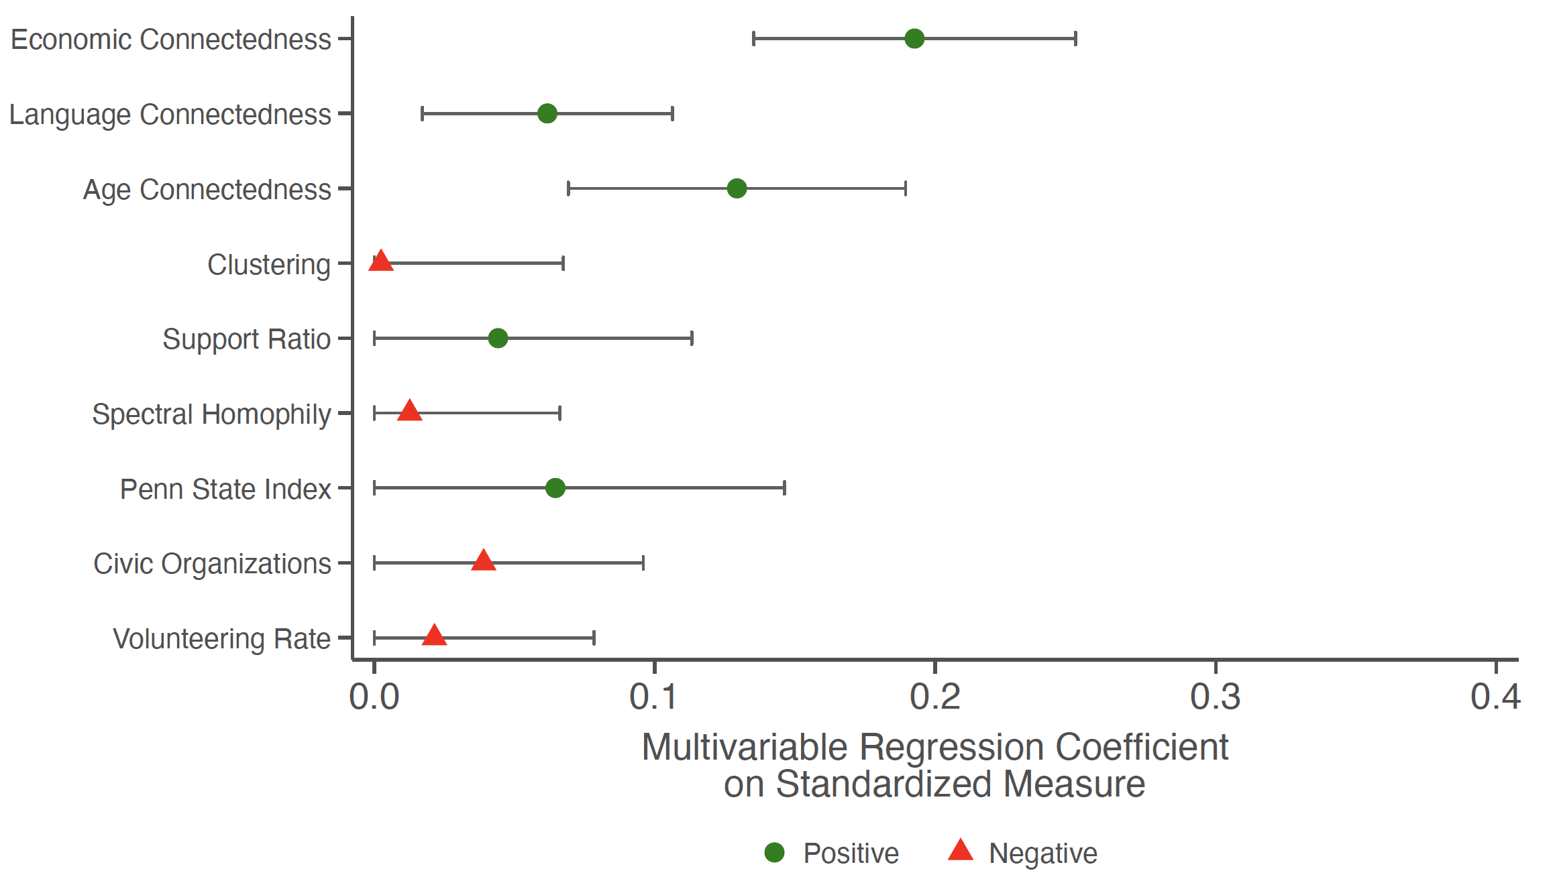
Regression of Counties’ Causal Effects on Upward Mobility on Social Capital
Multivariable Regression Coefficients
Notes:
1-SI-6A

Slide 35
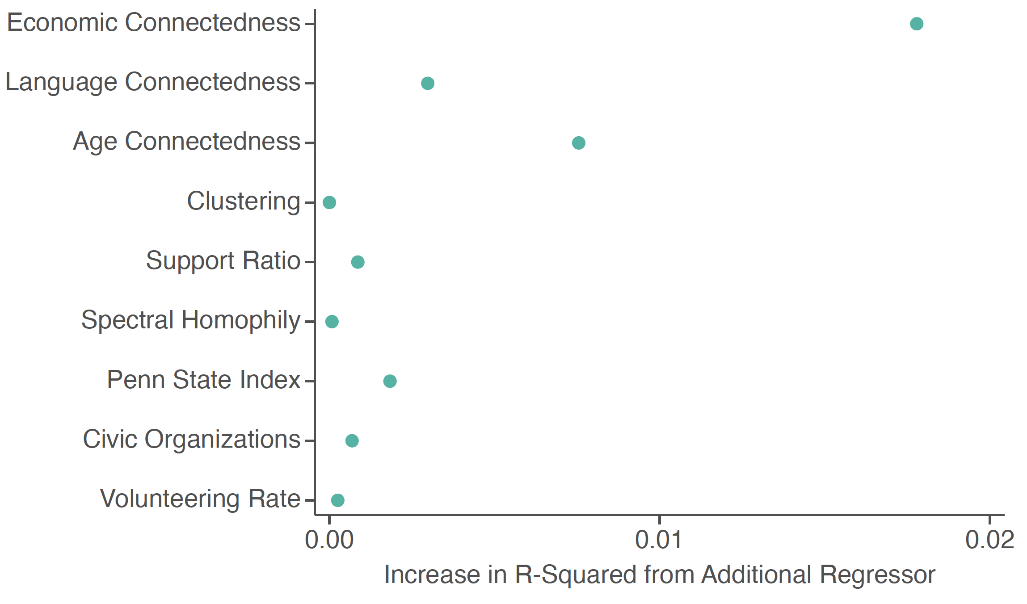
Regression of Counties’ Causal Effects on Upward Mobility on Social Capital
Incremental R-Squared
Notes:
1-SI-6B

Slide 36
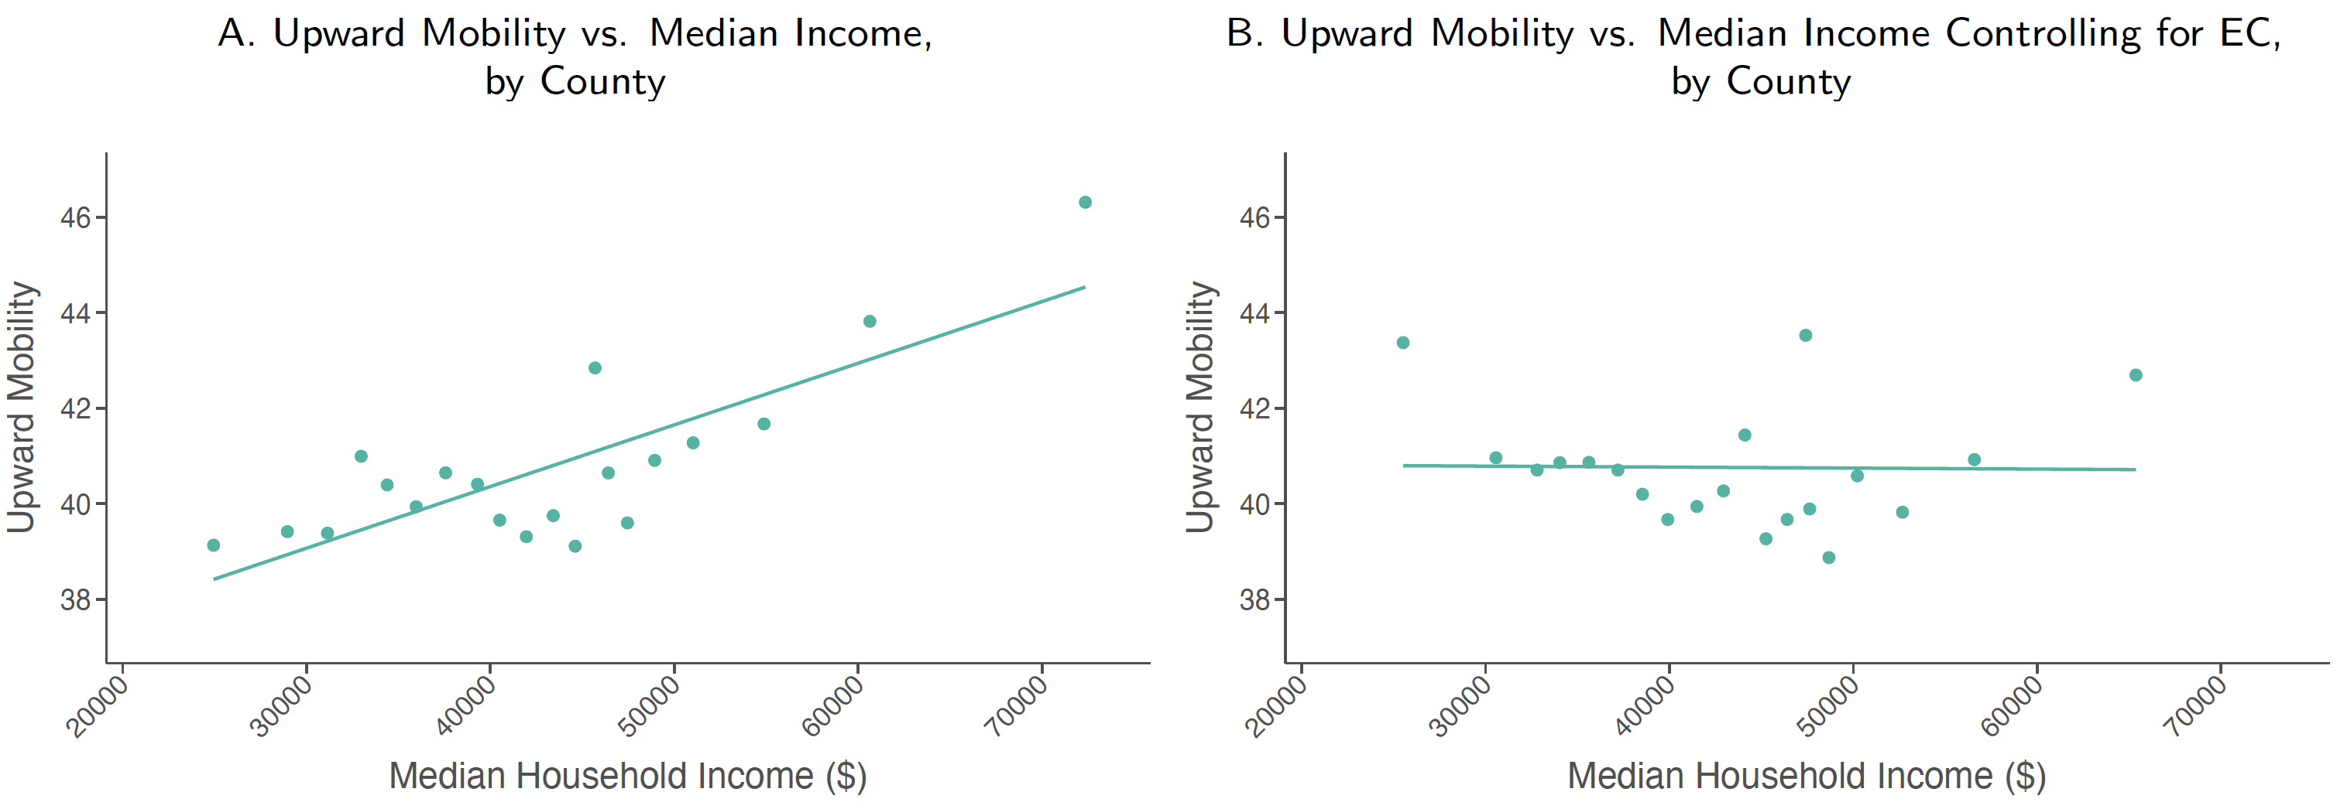
Upward Mobility, EC, and Income Levels across Counties
Median Household Income vs. Upward Mobility
Notes:
1-SI-7A, B

Slide 37
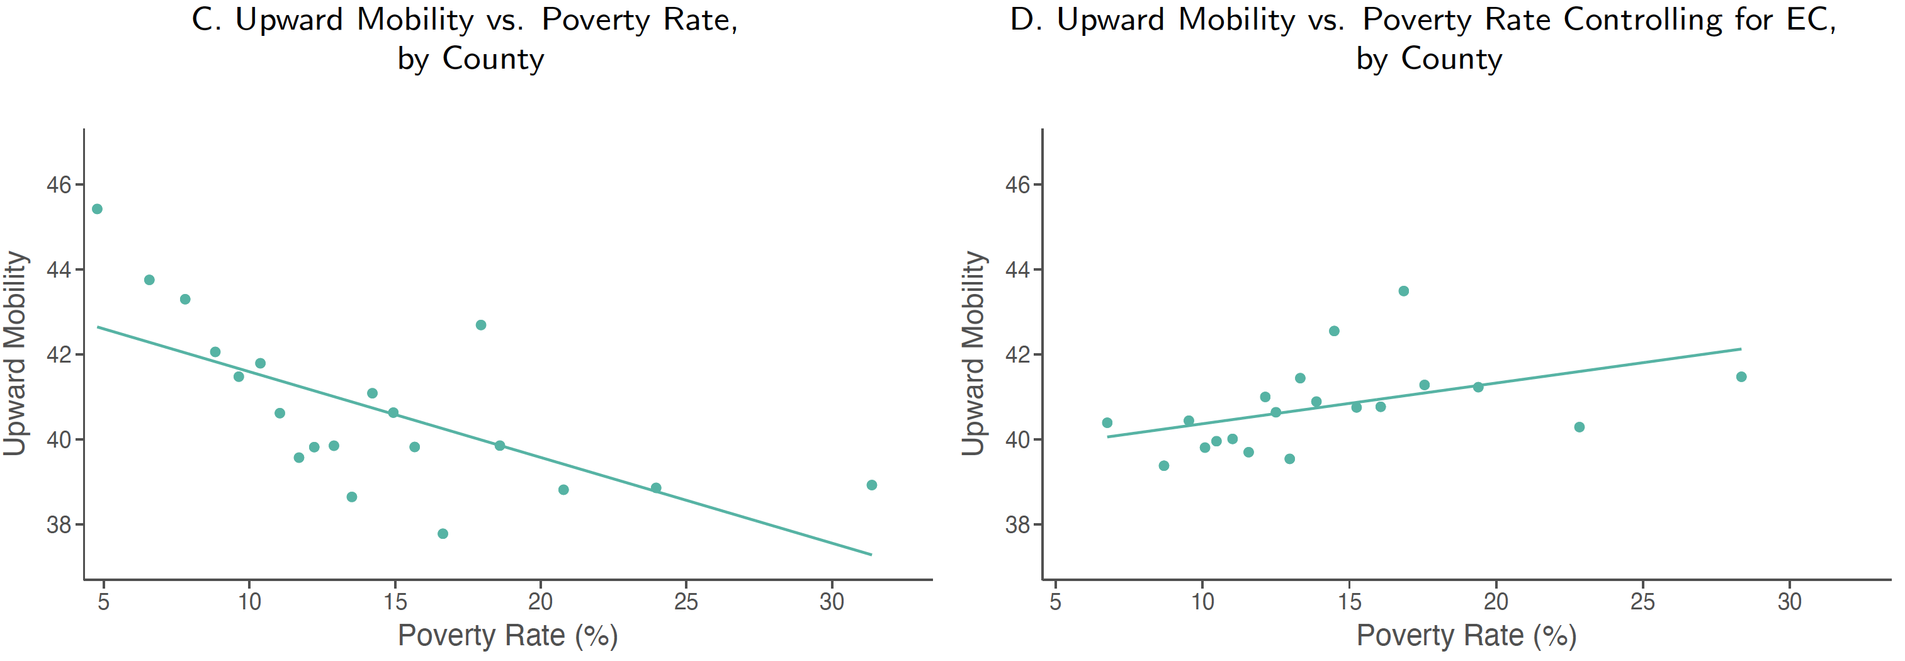
Upward Mobility, EC, and Income Levels across Counties
Poverty Rate vs. Upward Mobility
Notes:
1-SI-7C, D

Slide 38
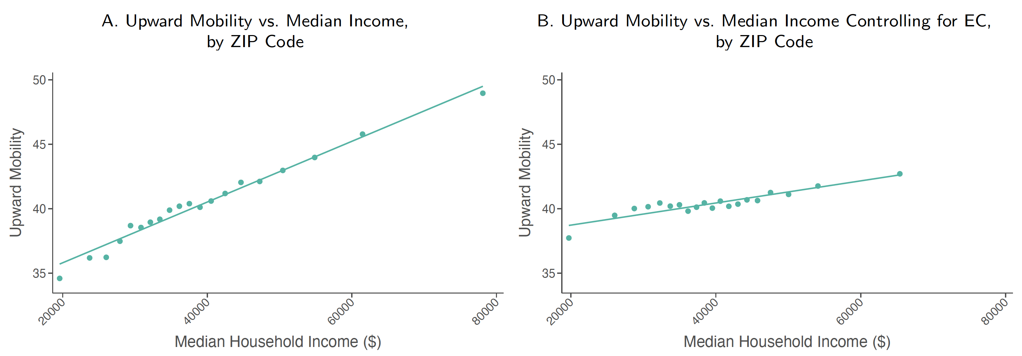
Upward Mobility, EC, and Income Levels across ZIPs
Median Household Income vs. Upward Mobility
Notes:
1-SI-8A, B

Slide 39
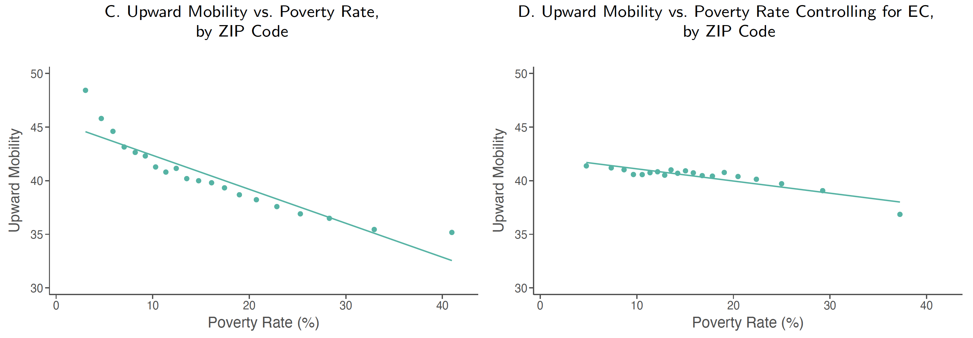
Upward Mobility, EC, and Income Levels across ZIPs
Poverty Rate vs. Upward Mobility
Notes:
1-SI-8C, D

Slide 40
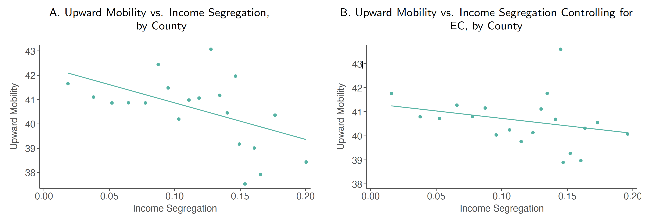
Upward Mobility, EC, and Inequality and Segregation across Counties
Income Segregation vs. Upward Mobility
Notes:
1-SI-9A, B

Slide 41
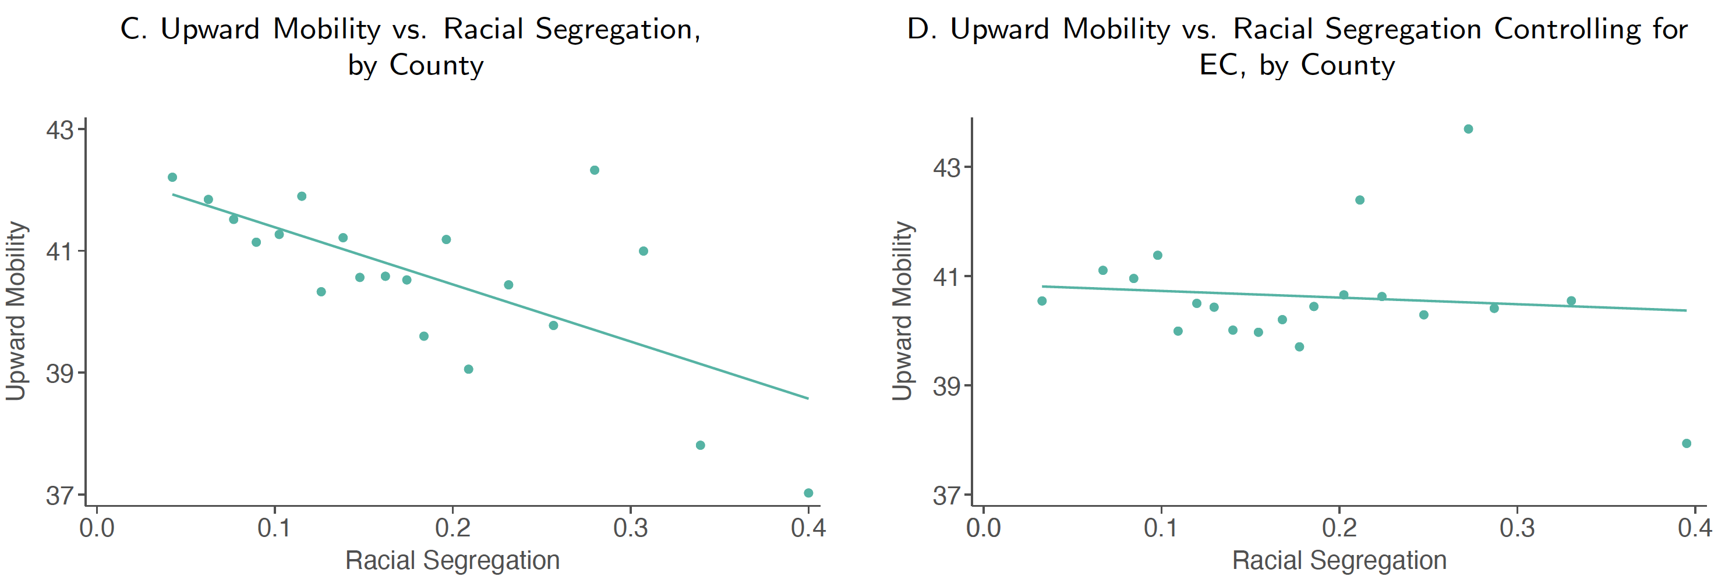
Upward Mobility, EC, and Inequality and Segregation across Counties
Racial Segregation vs. Upward Mobility
Notes:
1-SI-9C, D

Slide 42
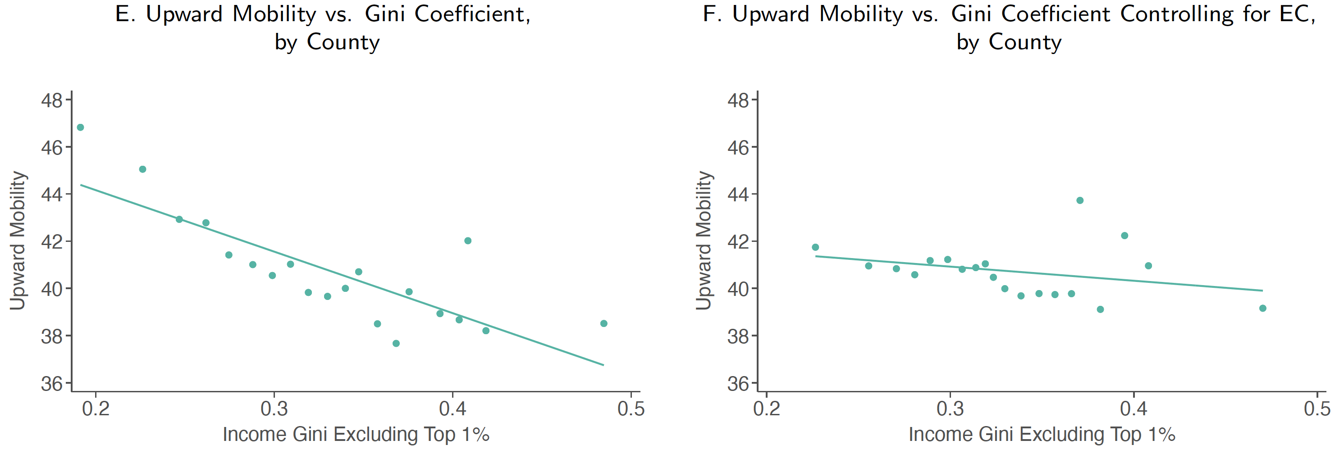
Upward Mobility, EC, and Inequality and Segregation across Counties
Gini Coefficient vs. Upward Mobility
Notes:
1-SI-9E, F

Slide 43
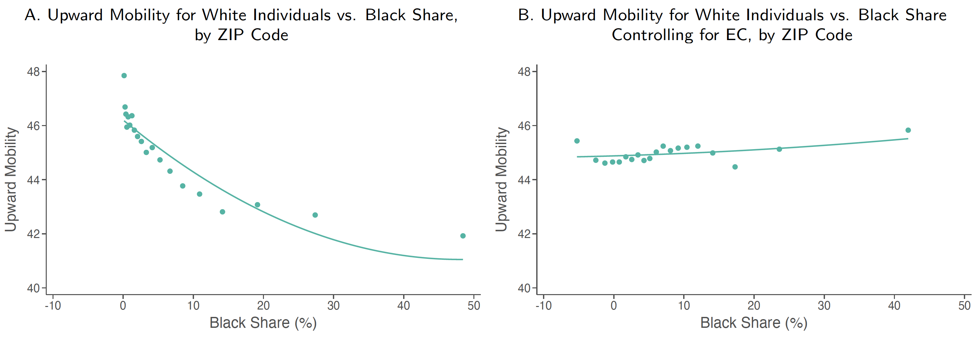
Upward Mobility, EC, and Share of Black Residents across ZIPs
Black Share vs. Upward Mobility for White Individuals
Notes:
1-SI-10A, B

Slide 44
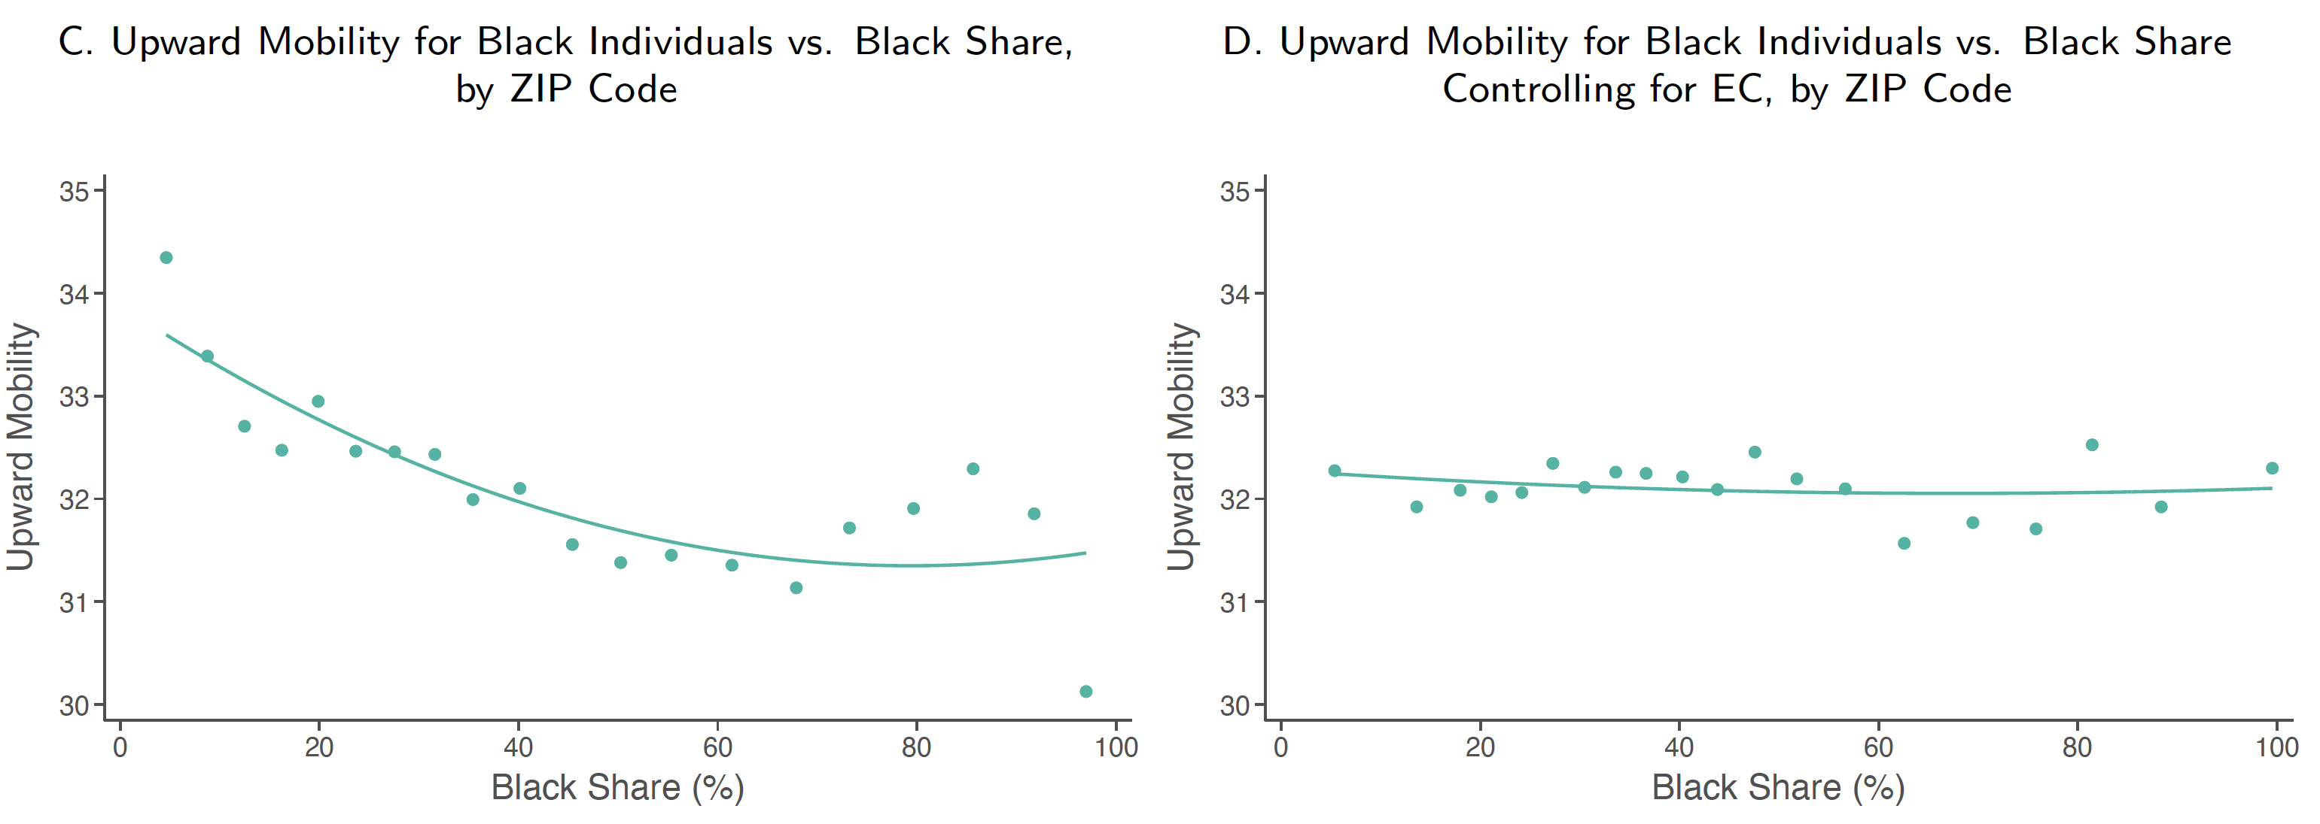
Upward Mobility, EC, and Share of Black Residents across ZIPs
Black Share vs. Upward Mobility for Black Individuals
Notes:
1-SI-10C, D

Slide 45
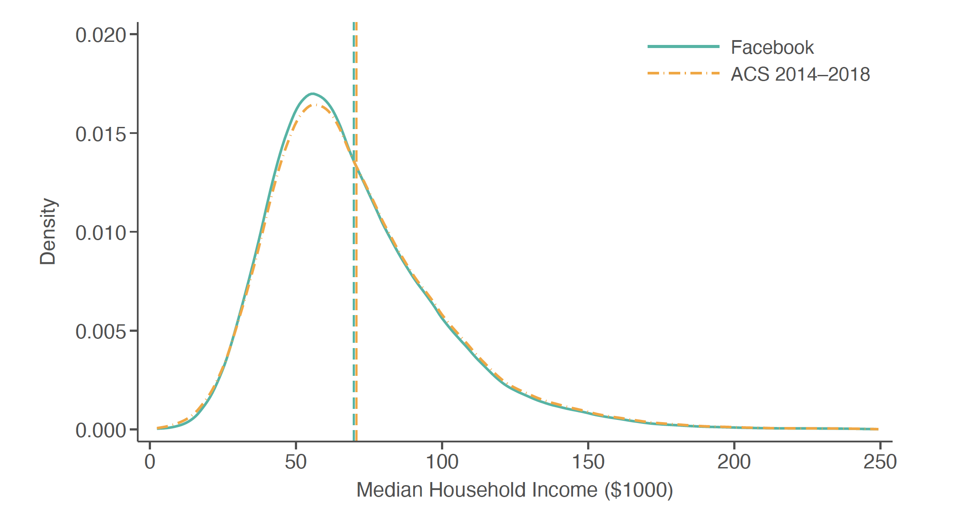
Distribution of ZIP-level Incomes in Facebook Data vs. ACS
Ages 25 to 44
Notes:
1-SI-13A

Slide 46
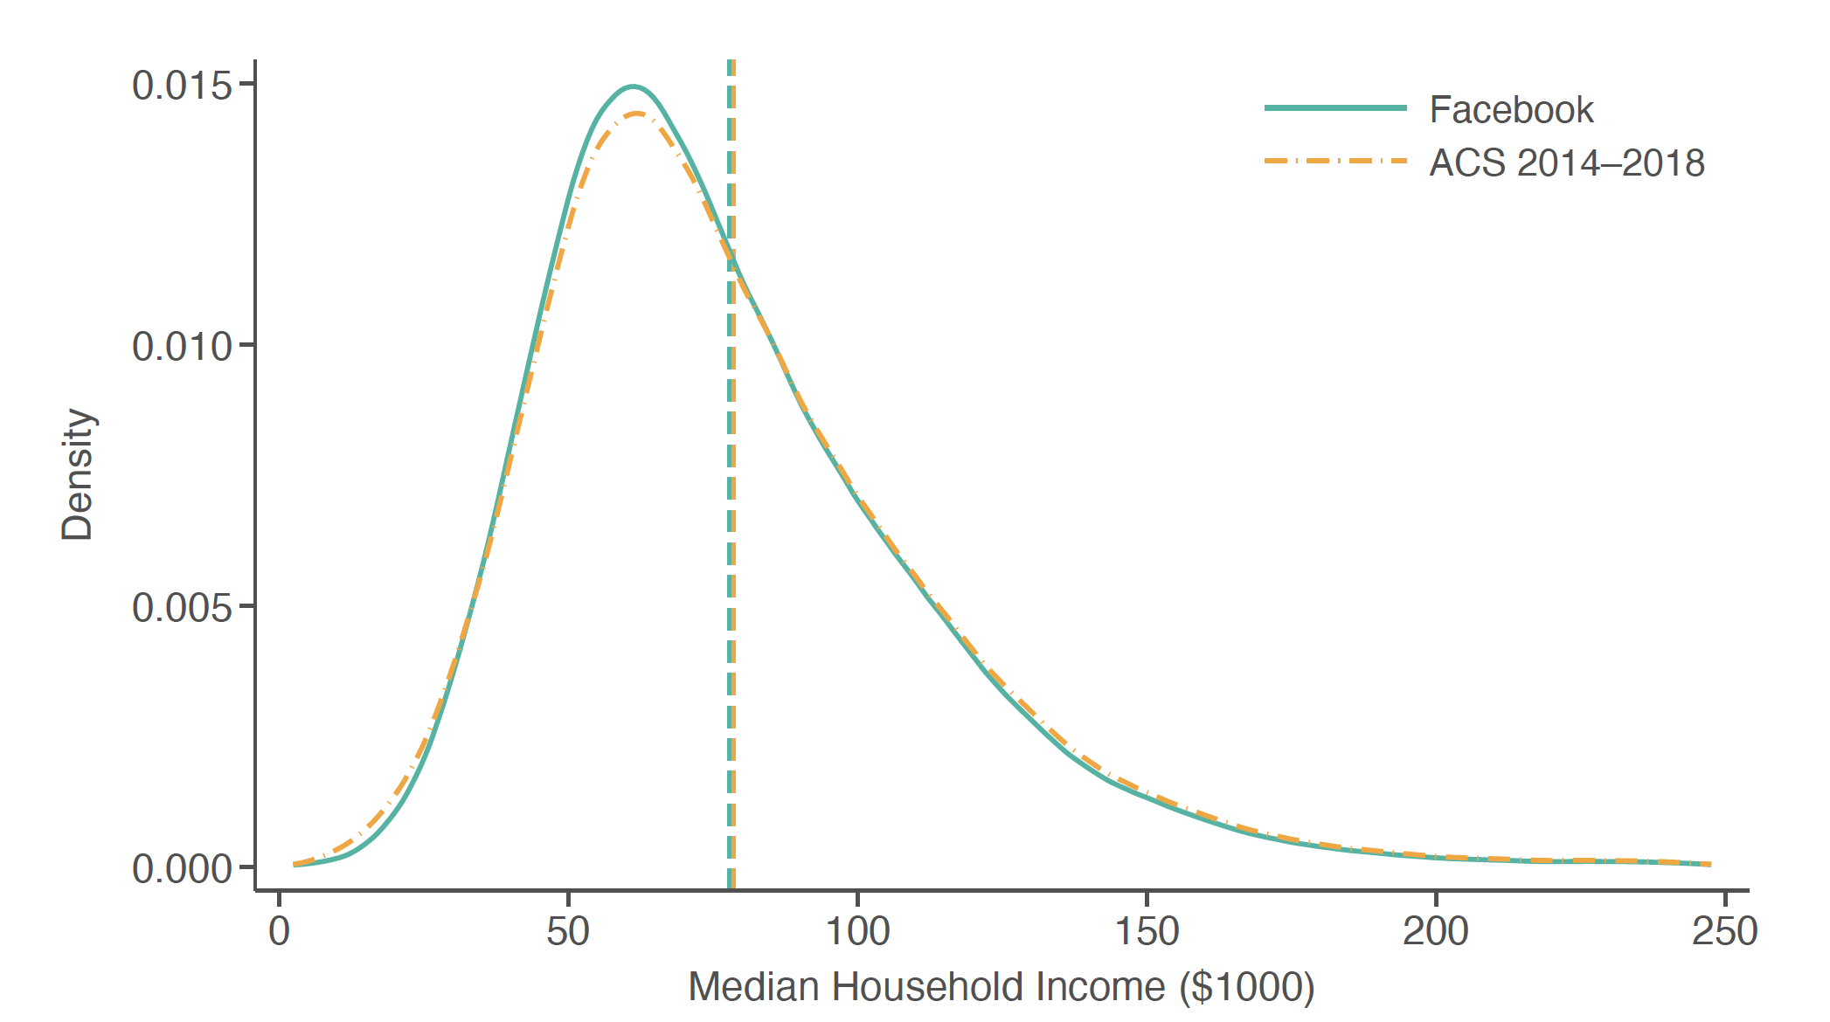
Distribution of ZIP-level Incomes in Facebook Data vs. ACS
Ages 45 to 64
Notes:
1-SI-13B

Slide 47

County-level Correlations for Top 25% of Counties by FB Coverage Rates
Social Capital vs. Upward Mobility
Notes:
1-SI-14A

Slide 48

County-level Correlations for Top 25% of Counties by FB Coverage Rates
Neighbourhood Characteristics vs. Upward Mobility
Notes:
1-SI-14B

Slide 49

Relationship Between Friends’ and Own SES on Instagram
Notes:
1-SI-15

Slide 50

Predictors of Friending Bias across Settings
Friending Bias vs. Group Size
Notes:
2-SI-1A

Slide 51

Predictors of Friending Bias across Settings
Friending Bias vs. High-SES Exposure
Notes:
2-SI-1B

Slide 52

Friending Bias vs. Exposure to High-SES Students, by High School
Among Low-Own-SES Students in 1990-2000 Birth Cohorts
Notes:
2-SI-2A

Slide 53

Friending Bias vs. Exposure to High-SES Students, by College
Among Low-Own-SES Students in 1990-2000 Birth Cohorts
Notes:
2-SI-2B

Slide 54

Friending Bias in Colleges vs. School Cohort Size
Bias Measured using Parental SES
Notes:
2-SI-3A

Slide 55

Friending Bias in Colleges vs. Exposure
Bias Measured using Parental SES
Notes:
2-SI-3B

Slide 56

Friending Bias in Colleges vs. Racial Diversity
Bias Measured using Parental SES
Notes:
2-SI-3C

Slide 57

Friending Bias in Colleges vs. Share White
Bias Measured using Parental SES
Notes:
2-SI-3D

Slide 58
Friending Bias in High Schools vs. AP Enrollment
Bias Measured using Parental SES
Notes:
2-ED-1A

Slide 59
Friending Bias in High Schools vs. School Size
Friending Bias in High Schools vs.
Bias Measured using Parental SES
Notes:
2-ED-1C

Slide 60
Friending Bias in High Schools vs. Socioeconomic Diversity
Bias Measured using Parental SES
Notes:
2-ED-1D

Slide 61
Friending Bias in High Schools vs. Racial Diversity
Bias Measured using Parental SES
Notes:
2-ED-1D

Slide 62

Friending Rates by Setting
Correcting for Underreporting of Group Memberships
Notes:
2-SI-4A

Slide 63

Decomposing EC
Correcting for Underreporting of Group Memberships
Notes:
2-SI-4B

Slide 64

Autocorrelation of EC by Birth Cohort
Across High Schools
Notes:
2-SI-5A, B

Slide 65

Autocorrelation of EC by Birth Cohort
Across Colleges
Notes:
2-SI-5C, D

Slide 66

Causal Effects of Changes in Socioeconomic Integration on Economic Connectedness in High Schools: Sensitivity Analysis
Using First Differences
Notes:
2-SI-6A, B

Slide 67

Causal Effects of Changes in Socioeconomic Integration on Economic Connectedness in High Schools: Sensitivity Analysis
Using Neighboring Cohorts
Notes:
2-SI-6C, D

Slide 68


Balance Tests for RD Design
Number of Friends and Share Female
Notes:
2-SI-7A, B

Slide 69

Causal Effects on Exposure on EC
Histogram of RD Estimates, Varying Bandwidth Around School Entry Cutoff
Notes:
2-SI-8

Slide 70

Proportion of Friendships by SES Percentile Rank
Proportion of Friends by SES Percentile Rank for Individuals in the Upper Tail
Notes:
1-SI-16B

Slide 71

Correlations between Upward Mobility and Neighborhood Characteristics
County-level Univariate Correlations
Notes:
1-5A

Slide 72

Correlations between Upward Mobility and Neighborhood Characteristics
County-level Multivariable Regression Coefficients
Notes:
1-5B

Slide 73

EC By Setting
Low-SES vs. High-SES People
Notes:
2-2A

Slide 74

Exposure By Setting
Low-SES vs. High-SES People
Notes:
2-2B

Slide 75

Friending Bias By Setting
Low-SES People
Notes:
2-2C

Slide 76

Friending Bias By Setting
Low-SES vs. High-SES People
Notes:
2-2C

Slide 77

Why Does Economic Connectedness Vary Across Areas? Low-EC vs. High-EC ZIP Codes
Notes:
2-3B

Slide 78

Causal Effects of Integration on Connectedness:
Regression Discontinuity
Changes in EC Around School Entry Cutoffs, by Friending Bias
Notes:
2-ED-4A

Slide 79

Causal Effects of Integration on Connectedness:
Regression Discontinuity
Impacts of Exposure on EC, by Friending Bias
Notes:
2-ED-4B

